Slide 1
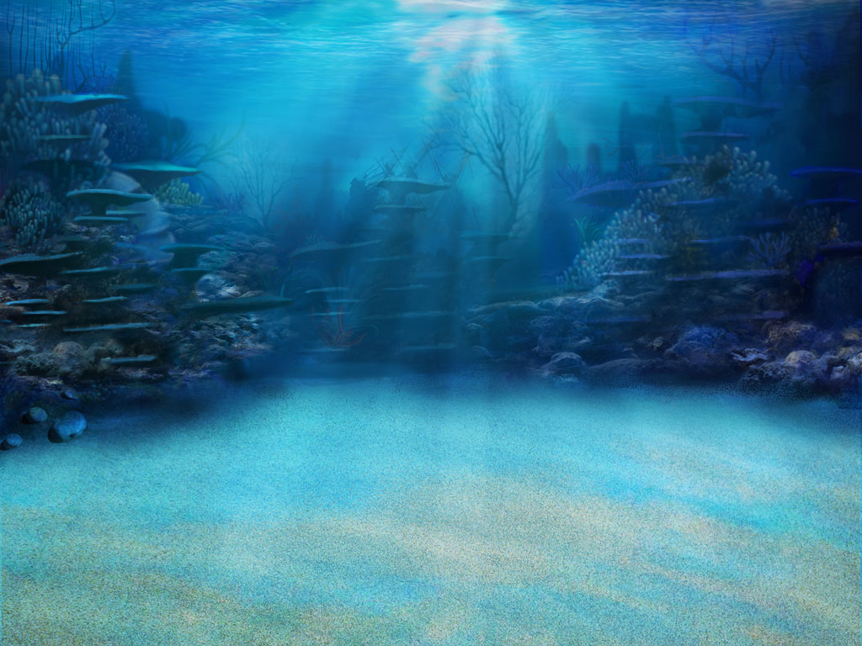
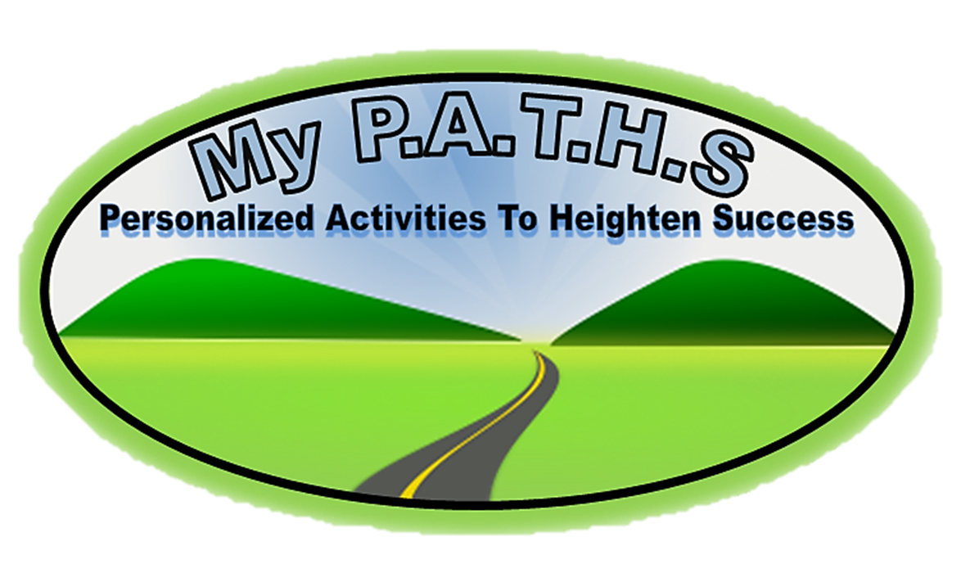
Product Purpose:
Having a challenge getting students to understand MAP and Common Core vocabulary? This game WILL help your students succeed! Words from the NWEA MAP site were placed in the specific RIT bands/Grade Levels associated with MAP.
This game is a great overview of all NWEA MAP vocabulary in the 141-170 RIT band.
This product includes the “Student Self-Assessment” sheet where students can assess their learning with each word while they go on their adventure!
Other RIT bands’ “Student Self-Assessment” sheets are included because some games include preview words for the next RIT band.
Click Logo

Slide 2
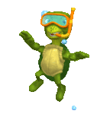
The Point Of The Game!!
Click Logo
In this game you will go on a underwater adventure as they investigate underwater life while trying to learn the critical vocabulary found in NWEA MAP RIT 141-170 and the Common Core. There are three games, with fifteen words in each games. This game can be paired with “NWEA MAP RIT 141-170 Student Tracking” sheet to allow students to self-assess and the teacher to progress monitor. Student click on a underwater species and a question floats in on the screen. Their goal is to click on the correct answer! Students can click on the floating turtle in the “My Progress” section to go to the selection page.
ALL NEW STUDENT WORD TRACKING FEATURE!!
When a student click on a word, the word appears under the “my progress” section as either being correct, or incorrect. Knowing how critical it is to understand what students know, this new feature allows both the teacher and the student to progress monitor! When accompanied with “NWEA MAP RIT 141-170 Student Tracking” sheet, both the teacher and student can set goals.
NWEA MAP RIT 141-170 Student Tracking Sheet Now Included!
To unlock the treasure chest, students simply click on the cage and a difficult question appears. If they get the question correct, the cage moves up and off the screen, and the chest is left opening and closing. This adds more excitement to the game.
MATERIALS: *Computers and/or *Classroom computer and Interactive Whiteboard

Slide 3
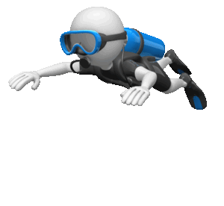
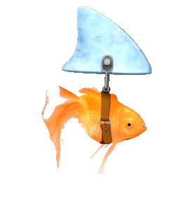
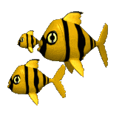
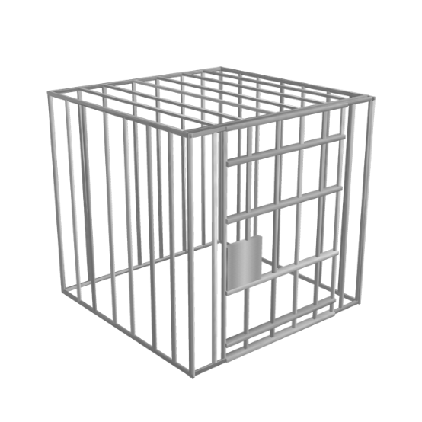
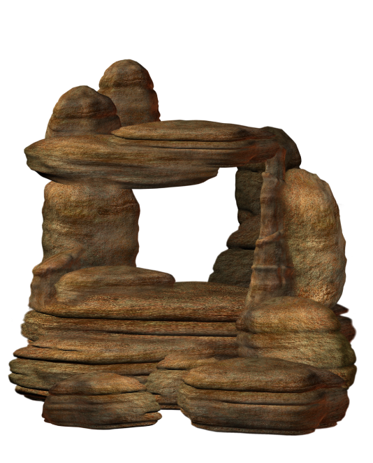
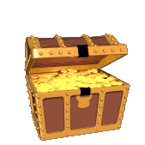
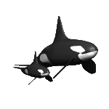
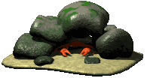
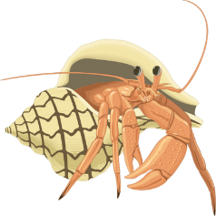
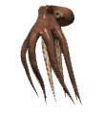
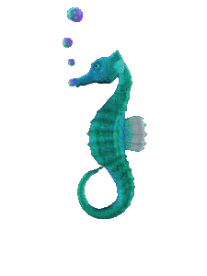
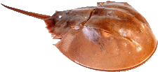
Jelly Fish 1.87 and .23
Green 1.86 and 1.15
Red 5.58 and 1
UNDERWATER ADVENTURE
NWEA MAP Reading VOCABULARY RIT 141-170
Click on the RIT column you would like to explore!
ADVENTURE 1:
RIT 141-170
Beginning Sound
Letter
Narrative ABC Order
Book
Ending Sound Paragraph Prefix Report Rhyme Riddle Sentence Classify Story
RIT 161-170 Advertisement
ADVENTURE 2:
American Literature
Base
Compound Word
Contraction
Directions
Fairy Tale
Folk Take
Index
List
Main Idea
Note
Nursery Rhyme
Opposite
Passage
Personal Narrative
ADVENTURE 3:
Poem
Problem
Question
Root
Setting
Sign Syllable Table of Contents
Vowel
RIT 171-180
Announcement
Article
Atlas
Author
Author’s Purpose
Bias

Slide 4
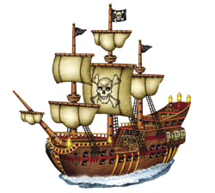
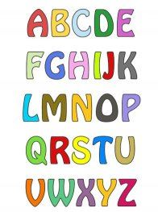
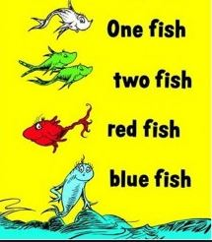
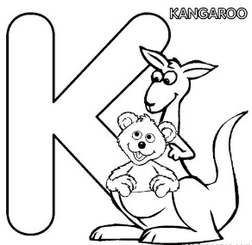
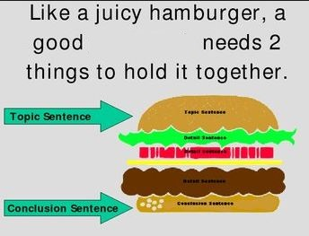
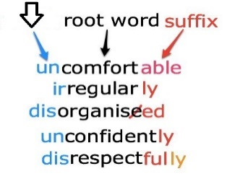
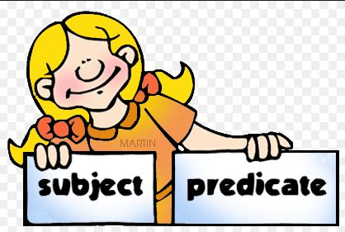
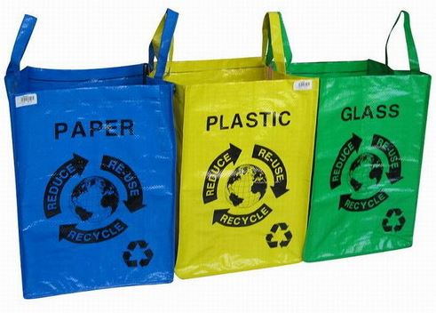
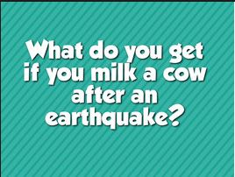
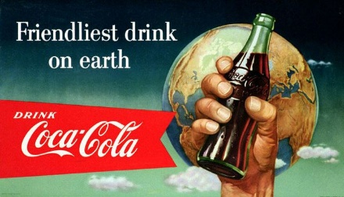
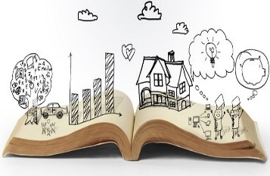
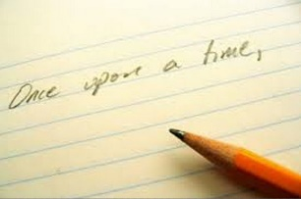
Jelly Fish 1.87 and .23
Green 1.86 and 1.15
Red 5.58 and 1
My Progress
Arrange (a group of people or things) in classes or categories according to shared qualities or characteristics. We will ____________ what groups all the animals belong to.
A distinct section of a piece of writing, usually dealing with a single theme and indicated by a new line, indentation, or numbering. The first ____________ tells us the name of the characters.
A word or group of words that expresses a complete idea and that includes a subject and a verb. The first word in a ______________ should start with a capital letter.
A spoken or written account of something that one has observed, heard, done, or investigated. My book ______________ is about the planets.
Beginning Sound
A mystifying, misleading, or puzzling question posed as a problem to be solved or guessed. Our teacher told our class a ____________ that nobody could solve.
A character representing one or more of the sounds used in speech; any of the symbols of an alphabet. Z is the last ______________ in the alphabet..
A written or printed work consisting of pages glued or sewn together along one side and bound in covers. Harry Potter is my favorite _________________.
A paid announcement, as of goods for sale, in newspapers or magazines, on radio or television. (Example:” It’s so easy, a caveman can do it”)
A spoken or written account of connected events; a story. A _________________ is another name for a story.
A group of letters added to the beginning of a word to change its meaning. “Dis-“ is the ______________ in disrespect.
One of two or more words or phrases that end in the same sounds. I like to ___________ the words bike and like.
Riddle
The sound at the beginning of each word. B is the ______________ __________ of ball.
In the order of the letters of the alphabet. The letters on our refrigerator are in __________ __________.
Letter
Classify
The sound that comes at the end of a word. Ck is the ______________ _____________ sound of duck.
Story
An account of imaginary or real people and events told for entertainment. My favorite ___________ is Winnie the Pooh
Book
Beginning Sound
Sentence
Book
Riddle
Ending Sound
ABC Order
Paragraph
Prefix
ABC Order
Letter
Book
Rhyme
Beginning Sound
Narrative
Advertisement
Prefix
Rhyme
Riddle
Narrative
Paragraph
Riddle
Sentence
Report
Story
Letter
Paragraph
Narrative
ABC Order
Book
Ending Sound
Paragraph
Prefix
Report
Rhyme
Riddle
The Largest ocean on Earth is the Pacific Ocean. It covers ____________ percent of the Earth’s surface
Sentence
30%
20%
90%
17%
Classify
Story
Advertisement

Slide 5
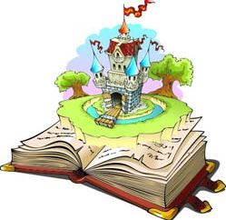
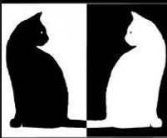
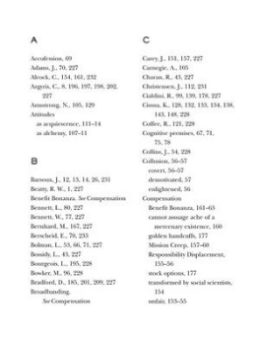
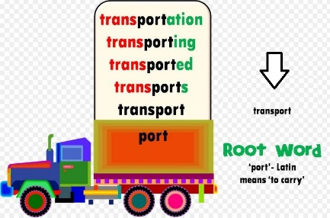
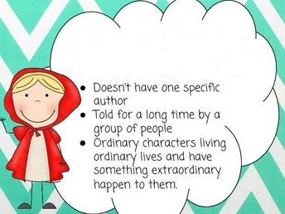
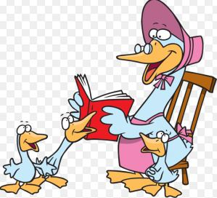
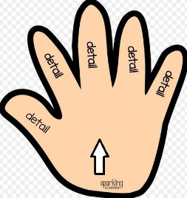
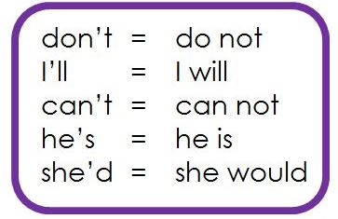
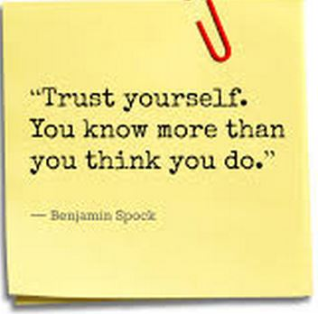
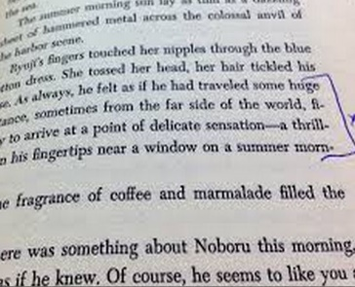
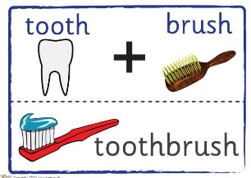
Jelly Fish 1.87 and .23
Green .64 and 1.12
Red 6.65 and 1.45
My Progress
Literature in English produced in what is now the United States of America. (Example: “The Grapes of Wrath” by John Steinbeck)
Tells the true story of something that happened to you. (Example: I am writing a _________ _________ to share the story of how I broke my arm.)
What the author wanted you to understand the most out of a nonfiction writing, speech, etc. (Example: The _ of the story was that cheaters never win.)
An alphabetical list of names, subjects, etc., with the page numbers where to find the information. Usually found in the back of the book. (Example: I wanted to know what page contained information about dinosaurs so I looked in the ____________)
A word produced by running two or more words together and leaving out some of the letters or sounds (example: Combining Can and not into Can’t)
American Literature
Writing down or making a mental note of things that you have to do. (Example: I made a shopping ___________ before I went to the store.)
A short informal letter or written message. (I had to get a _______ from my doctor so I could give it to the nurse at my school.)
Nursery
Rhyme
A portion or section of a written work; a paragraph, verse, etc. (Example: The part about fishing in the mountains is my favorite __________.) word “acrostic”)
A specific set of rules or guidance to complete a task (Example: The teacher gives the ______________ before taking the test.)
Main
Idea
Any belief or story passed on traditionally, especially one considered to be false or based on superstition (Example: Paul Bunyan)
Main
Idea
Base
Folk
Tale
A genre of story that often has princes, kings, dragons, princesses, and uses a lot of magic. (Example: The Princess and the Pea)
Personal
Narrative
Folk
Tale
A simple traditional song or poem for children. (Example: Mother Goose is my favorite ________.)
Note
American
Literature
Words that have completely different meanings. (Example: sun and moon)
Folk
Tale
Main
Idea
Index
Compound
Word
Fairy
Tale
The main word that prefixes and suffixes are added. (Example: port is in the word transportation)
Opposite
Passage
List
Fairy
Tale
The result of two words being joined (example: toothbrush)
Folk
Tale
Index
Index
Contraction
Base
Contraction
Directions
Note
Compound Word
Index
Compound
Word
Opposite
Compound
Word
Contraction
Contraction
Directions
Fairy Tale
Folk Tale
Index
List
Main Idea
Note
Nursery Rhyme
The second largest ocean on Earth is the Atlantic Ocean. It covers over ___________ % of the Earth’s surface.
Opposite
32%
21%
50%
90%
Passage
Personal Narrative

Slide 6
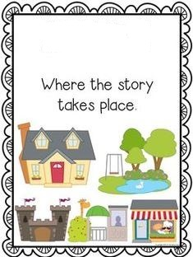
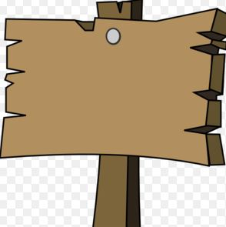
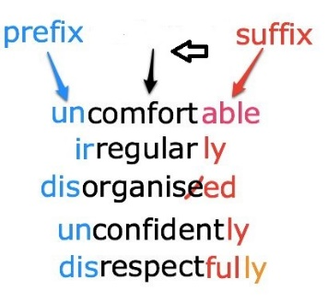
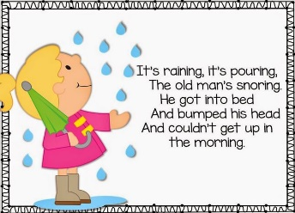
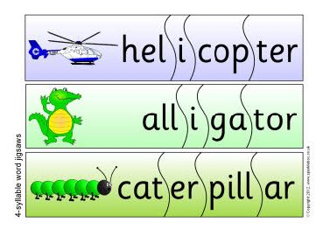
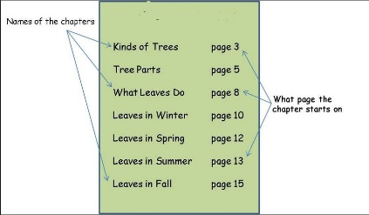
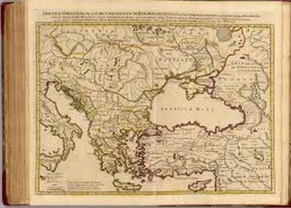
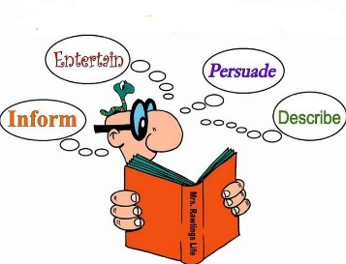
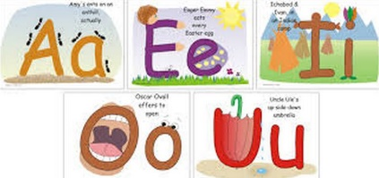
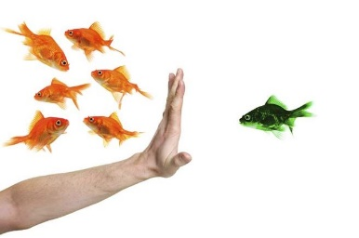
Jelly Fish 1.87 and .23
Green .64 and 1.12
Red 6.65 and 1.45
My Progress
When a person believes that some people, ideas, etc., are better than others that usually results in treating some people unfairly. (Example: The teacher had a ________ towards the girls because they didn’t talk as much during her class.)
A letter of the alphabet (a, e, i, o, u, and sometimes y) that represents a speech sound. (Example: A is the _________ in the word Far.)
A piece of paper, wood, etc., with words or pictures on it that gives information about something. (Example: We didn’t go in the house because the ________ said Stay Out!)
A sentence, phrase, or gesture that seeks information through a reply. (Example: I raised my hand so I could ask my teacher a ____________.)
The basis of a new word, but it does not typically form a stand-alone word on its own. (Example: Therm is the _______ word in Thermometer.)
Poem
A written or spoken statement that tells people about something. (The principal gave the _________ that there would be no recess today because of rain.)
A type of writing that usually uses rhyming, rhythm, descriptive language, and stanzas. (Roses are red, violets are blue…)
A piece of writing included with others in a newspaper, magazine, or other publication. (I read an ________ about the Fourth of July parade.)
Writing to persuade, to inform and/or to entertain (Example: The ______________ of writing the article was to make people laugh.) word “acrostic”)
A list of the different chapters of a book. (Example: I looked up what page chapter three starts on in the _______.
Part of a word that is pronounced with one uninterrupted sound. (Example: The word alligator has four ____________)
Table of Contents
A book of maps or charts. (Example: My mom had me look up the directions to Wyoming in the _______.)
Problem
Author
Author’s
Purpose
Bias
Root
Atlas
A question to be considered, solved, or answered. (Example: I am having a lot of trouble with this math ___________.)
Article
Announcement
The story's time and place. (Example: The __________ of the story was the 1850’s in the Old West.)
Atlas
Poem
Setting
Author’s
Purpose
A writer of a book, article, or report. (Example: I have read five books by the same ____________.)
Problem
Syllable
Sign
Table of
Contents
Author
Poem
Question
Index
Article
Fable
Vowel
Question
Syllable
Question
Vowel
Setting
Syllable
Biography
Problem
Root
Setting
Sign
Syllable
Table of Contents
Vowel
Announcement
Article
Atlas
The third largest ocean on Earth is the Indian Ocean. It covers __________ % of the Earth’s surface
Author
70%
2%
9%
14%
Author’s
Purpose
Bias

Slide 7
RESOURCE PAGE
THANK YOU TO PERSENTER MEDIA FOR PERMISSION TO USE ANIMATIONS, AND CLIPART FOR OUR PRODUCTS.
CONNECT WITH US AT:
mypersonalpaths@gmail.com
MyPATHS Blog
FACEBOOK
PINTEREST
RELATED PRODUCTS:
MAP TESTING READING QUIZZES COMPLETE RIT PACKAGE! (ALL RIT BANDS INCLUDED)
MAP TEST READING VOCABULARY GAME - Professor Lab coat (ALL RIT BANDS 141-260)
MAP TEST READING VOCABULARY GAME BUNDLE- Road Trip (ALL RIT BANDS 141-260)
MAP TEST READING VOCABULARY GAME - Real Bingo (ALL RIT BANDS 141-260)

