Slide 1
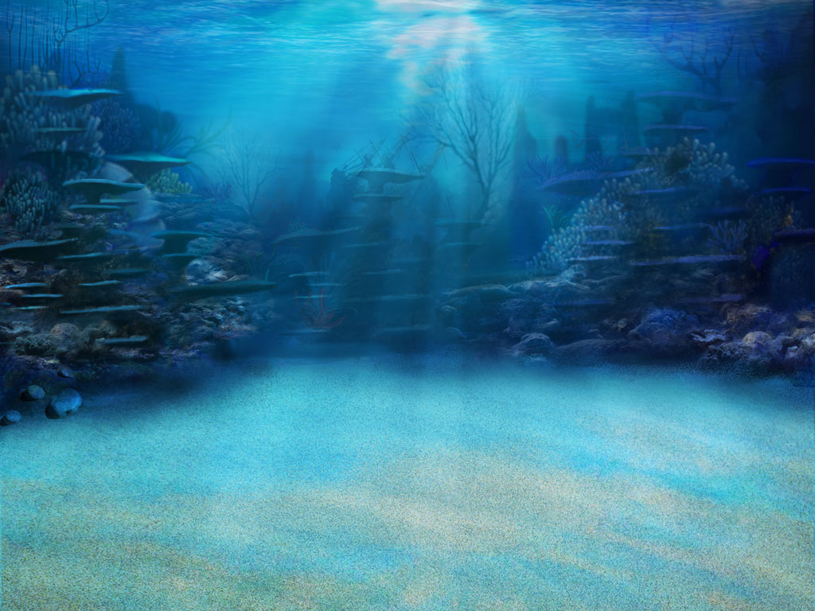
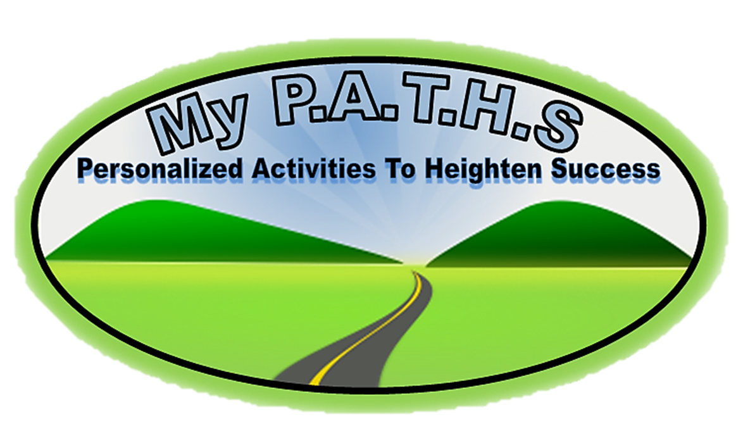
Product Purpose:
Having a challenge getting students to understand MAP and Common Core vocabulary? This game WILL help your students succeed! Words from the NWEA MAP site were placed in the specific RIT bands/Grade Levels associated with MAP.
This game is a great overview of all NWEA MAP vocabulary in the 171-180 RIT band.
This product includes the “Student Self-Assessment” sheet where students can assess their learning with each word while they go on their adventure!
Other RIT bands’ “Student Self-Assessment” sheets are included because some games include preview words for the next RIT band.
Click Logo

Slide 2
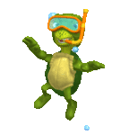
The Point Of The Game!!
Click Logo
In this game you will go on a underwater adventure as they investigate underwater life while trying to learn the critical vocabulary found in NWEA MAP RIT 171-180 and the Common Core. There are three games, with fifteen words in each games. This game can be paired with “NWEA MAP RIT 171-180 Student Tracking” sheet to allow students to self-assess and the teacher to progress monitor. Student click on a underwater species and a question floats in on the screen. Their goal is to click on the correct answer! Students can click on the floating turtle in the “My Progress” section to go to the selection page.
ALL NEW STUDENT WORD TRACKING FEATURE!!
When a student click on a word, the word appears under the “my progress” section as either being correct, or incorrect. Knowing how critical it is to understand what students know, this new feature allows both the teacher and the student to progress monitor! When accompanied with “NWEA MAP RIT 171-180 Student Tracking” sheet, both the teacher and student can set goals.
NWEA MAP RIT 171-180 Student Tracking Sheet Now Included!
To unlock the treasure chest, students simply click on the cage and a difficult question appears. If they get the question correct, the cage moves up and off the screen, and the chest is left opening and closing. This adds more excitement to the game.
MATERIALS: *Computers and/or *Classroom computer and Interactive Whiteboard

Slide 3
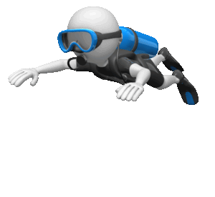
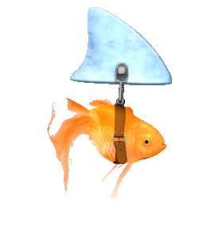
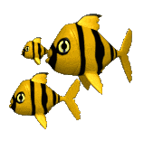
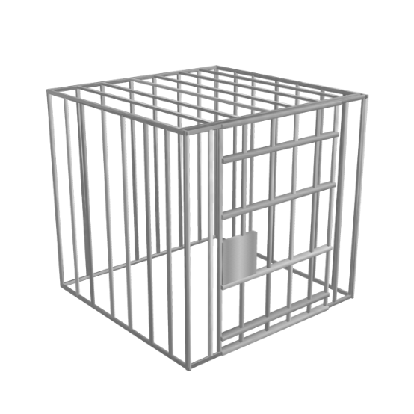
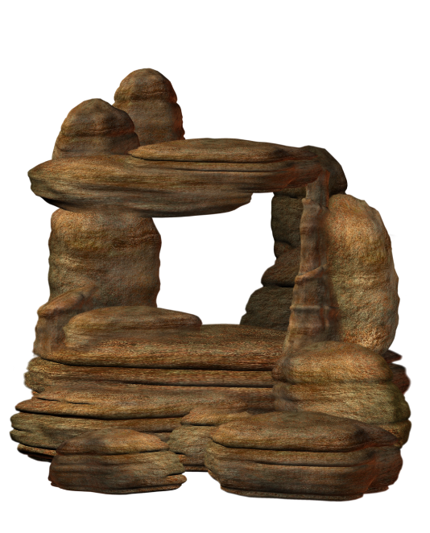
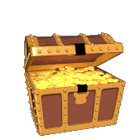
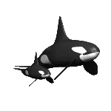
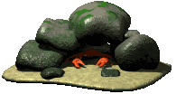
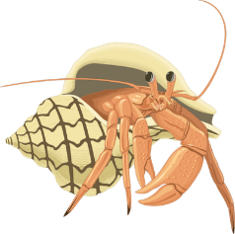
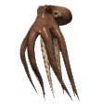
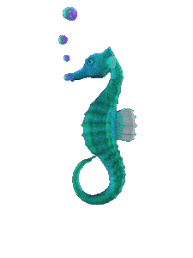
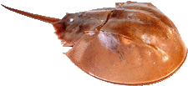
Jelly Fish 1.87 and .23
Green 1.86 and 1.15
Red 5.58 and 1
UNDERWATER ADVENTURE
NWEA MAP/COMMON CORE VOCABULARY RIT 171-180
ADVENTURE 1:
RIT 171-180
Announcement
Article Atlas
Author
Author’s Purpose Bias Biography Business Letter Category Chapter Character Cookbook Dictionary Effect Fable
ADVENTURE 2:
Fact
Fantasy
Journal
Label
Main Character
Make-believe
Newspaper
Nonfiction
Opinion
Persuasive Essay
Root Word
Rule
Schedule
Science Fiction
Short Story
ADVENTURE 3:
Statement
Suffix
Tall Tale
Text Book Title Title Page
RIT 181-190
Almanac
Antonym
Bibliography
Cause
Effect
Fiction
Genre
Glossary
Outline

Slide 4
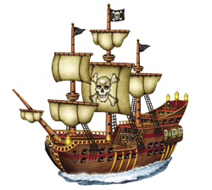
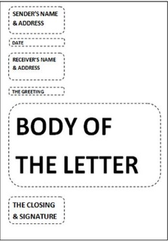
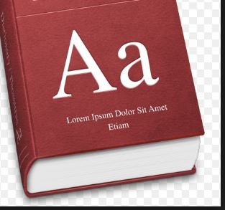
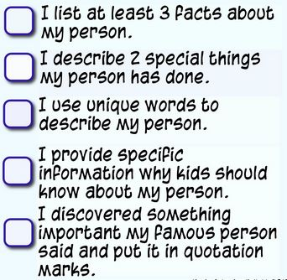
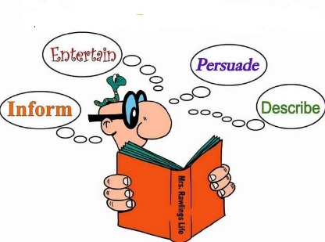
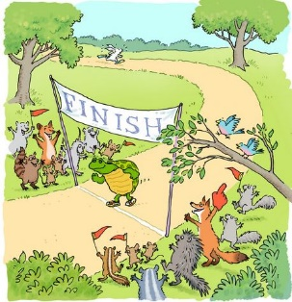
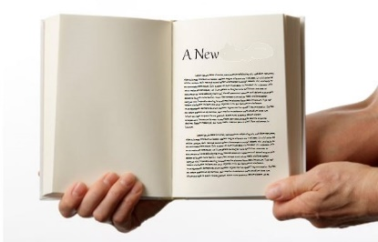
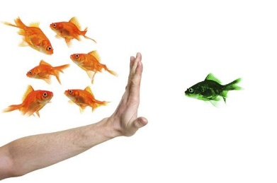
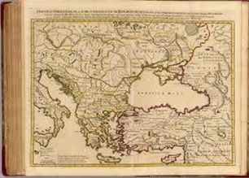
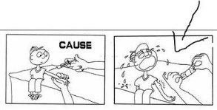
Jelly Fish 1.87 and .23
Green .64 and 1.12
Red 6.65 and 1.45
My Progress
A reference book that contains words listed in alphabetical order and that gives information about the words' meanings, forms, pronunciations, etc. I had to look up the word contagious in the ____________.
When a person believes that some people, ideas, etc., are better than others that usually results in treating some people unfairly. (Example: The teacher had a ________ towards the girls because they didn’t talk as much during her class.)
A written or spoken statement that tells people about something. (The principal gave the _________ that there would be no recess today because of rain.)
A professional letter written from a place of work to someone, or to another work place. I got ____________ in the mail telling me I didn’t get offered a job.
Writing to persuade, to inform and/or to entertain (Example: The ______________ of writing the article was to make people laugh.)
A group of people or things that are similar in some way. The history _________ on "Jeopardy!" is my favorite.
Announcement
A piece of writing included with others in a newspaper, magazine, or other publication. (I read an ________ about the Fourth of July parade.)
A book containing recipes and instructions for cooking. I found a great recipe for Mac and Cheese in my mom’s _____________.
A short story that usually is about animals and that is intended to teach a lesson. One of my favorite ________ is the Tortoise and the Hare.
Books are divided into these different sections. The book introduced the main character in ___________ one.
An account of someone's life written by someone else. Have you read the ________________ of Martin Luther King?
A person who appears in a story, book, play, movie, or television show. Stuart is my favorite _________ in the movie Minions.
A change that results when something is done or happens. The defeat had a terrible _______ on the team's spirits.
A writer of a book, article, or report. (Example: I have read five books by the same ____________.)
Article
A book of maps or charts. (Example: My mom had me look up the directions to Wyoming in the _______.)
Author’s
Purpose
Effect
Fable
Dictionary
Fairy
Tale
Author
Business
Letter
Character
Category
Cookbook
Character
Author
Author
Biography
Bias
Chapter
Index
Biography
Cause
Atlas
Atlas
Effect
Announcement
Article
Category
Biography
Biography
Article
Category
Chapter
Character
Author
Author’s Purpose
Bias
Biography
Business Letter
Category
Chapter
Character
During winter the Arctic Ocean is covered by what percent Ice?
Cookbook
Dictionary
78%
2%
99%
45%
Effect
Fable

Slide 5
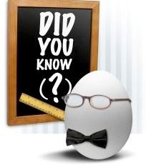
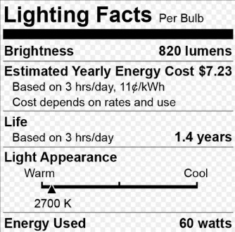
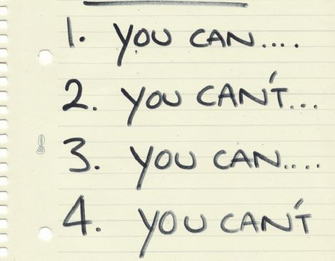
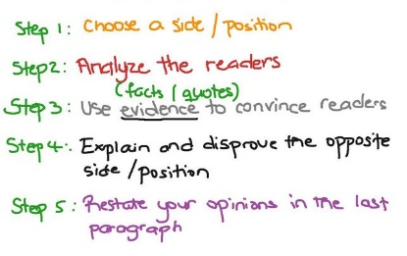
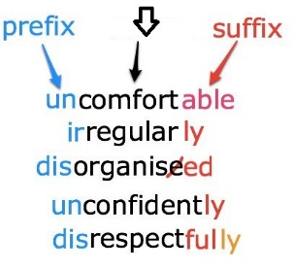
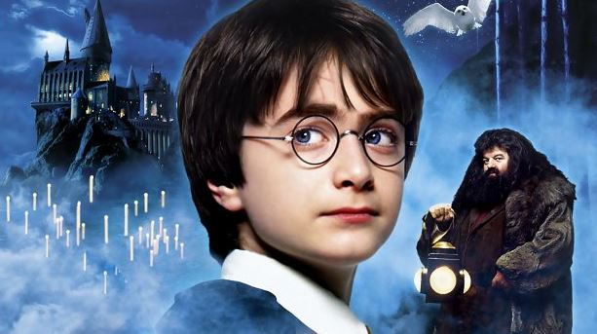
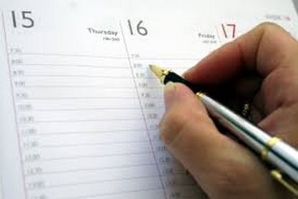
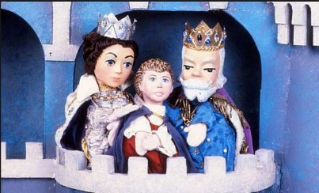
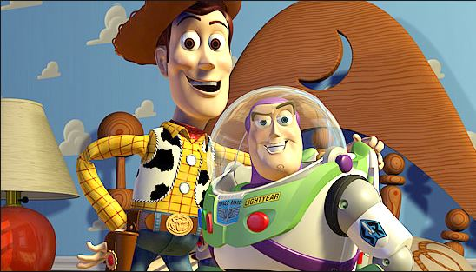
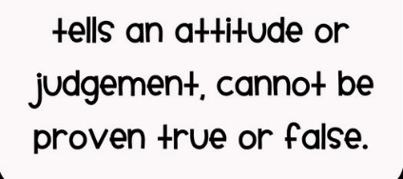
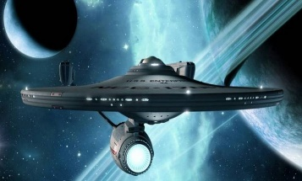
Jelly Fish 1.87 and .23
Green .64 and 1.12
Red 6.65 and 1.45
My Progress
A word or phrase that describes or identifies something or someone. The back of the food ________ told me how much sugar was in box of cereal.
A publication, usually issued daily or weekly, containing current news, editorials, feature articles, and usually advertising. I found an ad in the __________ to try and sell by bicycle.
A word that stands by itself and means something. Sometimes prefixes and suffixes are added to these words to change their meanings. The _________ of uncomfortable in comfort.
A statement that tells you what is or is not allowed in a particular game, situation, etc. My brother always breaks a ____________ when we play monopoly.
A belief, judgment, or way of thinking about something: what someone thinks about a particular thing. In my _______ Taylor Swift is the best singer.
The person/animal in a story of any kind, book, movie, TV show, who has the most important part in the story. The ______________ in Toy Story was Woody.
An essay in which you attempt to get the reader to agree with your point of view. The President wrote a ________ to try and convince people to conserve water.
Fact
A written or printed list of things and the times when they will be done. My mom keeps a ___________ of everything she eats during the day.
A book in which you write down your personal experiences and thoughts. Lewis and Clark kept all of their information in a ____________.
A quick read that usually dealing with few characters. Our teacher likes to read us __________ out loud before recess.
A book, movie, etc., that tells a story about things that happen in an imaginary world. One of my favorite ___________ is Harry Potter and the Chamber of Secrets.
Short
Story
Stories about how people and societies are affected by imaginary scientific developments in the future. Star Wars is my favorite ________ movie.
Root
Word
Science
Fiction
A true piece of information. The book is filled with interesting ______and figures.
Rule
Fantasy
Label
The action of pretending or imagining. My sister and I like to pretend we live in the land of _________.
Label
Schedule
Writing that is about facts or real events. History books are a good example of ___________.
Fabel
Persuasive
Essay
Note
Fact
Journal
Make-believe
Journal
Fantasy
Fable
Fact
Fantasy
Journal
Journal
Journal
Newspaper
Journal
Outline
Fable
Main Character
Statement
Opinion
Nonfiction
Opinion
Newspaper
Label
Main Character
Make-believe
Newspaper
Nonfiction
Opinion
Persuasive Essay
Root Word
Amelia Earhart became the first female to fly solo across this ocean.
Rule
Pacific
Atlantic
Arctic
Indian
Schedule
Science
Fiction
Short Story

Slide 6
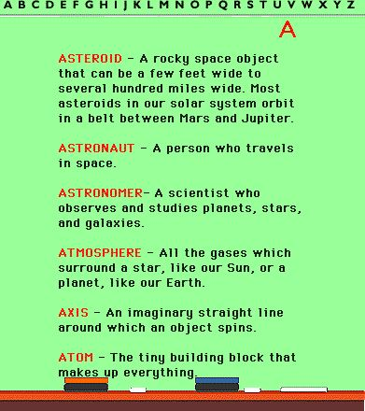
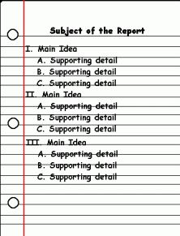
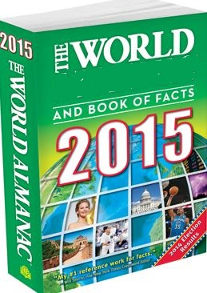
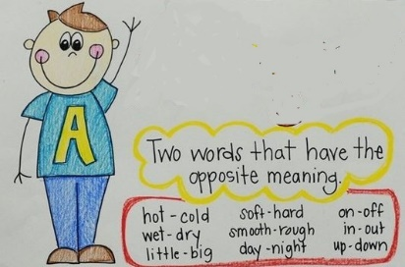
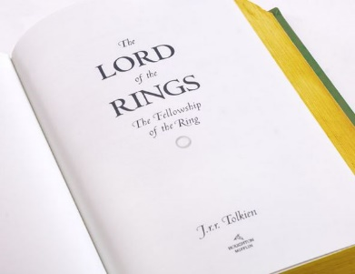
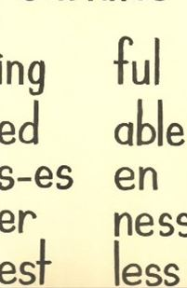
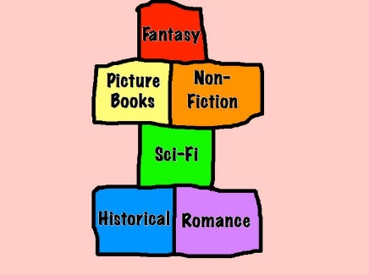
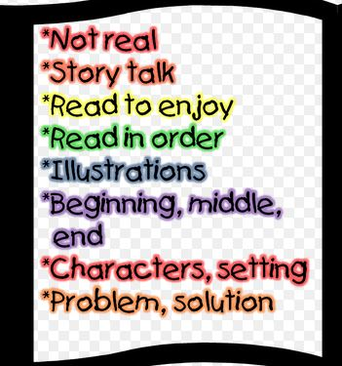
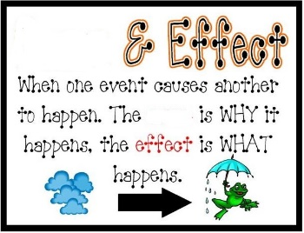
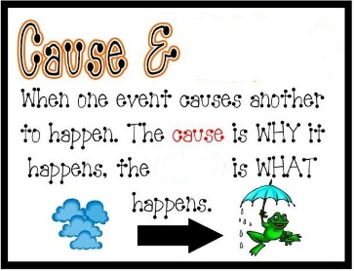
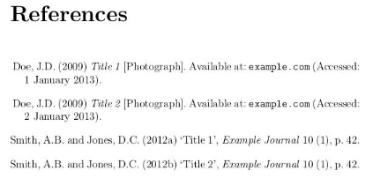
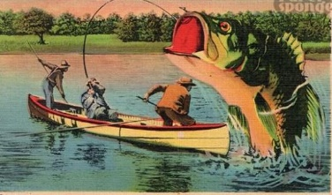
Jelly Fish 1.87 and .23
Green .64 and 1.12
Red 6.65 and 1.45
My Progress
A written list or description of only the most important parts of an essay, speech, plan, etc. Before I write my paper our teacher recommends that we make an _______.
A type of book used in school that gives you information about a subject. We put book covers on our Math ________ today in class.
Statement
A story that uses exaggerations (hyperboles) and is very difficult to believe. Paul Bunyan swung an ax and chopped down a whole forest.
The name given to something (such as a book, song, or movie) to identify or describe it. The ________ of the book is Gone With The Wind.
This happens because something caused it to happen. The _____________ of the tornado was that the family had to find a new home.
A list of books, magazines, articles, etc., that are mentioned in a text. The author of the article was mentioned in the ______________.
A book published every year that contains detailed information on a special subject. The Farmer’s _________ says it is going to be a cold winter.
A list that gives definitions of the hard or unusual words found in a book. I looked up the definition of the word found in my textbook in the _____________.
Text
Book
A letter or a group of letters that is added to the end of a word to change its meaning or to form a different word. Less in the word helpless is the _________.
Written stories about people and events that are not real. The short story about zombies is ____________.
Genre
A word with a meaning that is opposite to the meaning of another word. Hot is a/an _____________ of cold.
Different types of stories and writings. My favorite ___________ to read is fantasy.
Suffix
Something or someone that makes something else happen. Texting was the __________ of the car accident.
A page in the front of a book that includes the book's title. I put my name as the author in the _______ of my story.
Title
Tall
Tale
Effect
Glossary
Shtort
Story
Fiction
Cause
Something that you say or write in a formal or official way. He made a _________ to the police.
Outline
Title
Page
Cause
Non Fiction
Index
Statement
Bibliography
Short Story
Effect
Fairy Tale
Suffix
Prefix
Fiction
Index
Almanac
Prefix
Tall Tale
Statement
Diagram
Diagram
Antonym
Schedule
Text Book
Title
Title Page
Almanac
Antonym
Bibliography
Cause
Effect
The Atlantic Ocean’s name refers to what Greek God?
Fiction
Genre
Atlas
Zeus
Hermes
Thor
Glossary
Outline

Slide 7
RESOURCE PAGE
THANK YOU TO PERSENTER MEDIA FOR PERMISSION TO USE ANIMATIONS, AND CLIPART FOR OUR PRODUCTS.
CONNECT WITH US AT:
mypersonalpaths@gmail.com
MyPATHS Blog
FACEBOOK
PINTEREST
RELATED PRODUCTS:
MAP TESTING READING QUIZZES COMPLETE RIT PACKAGE! (ALL RIT BANDS INCLUDED)
MAP TEST READING VOCABULARY GAME - Professor Lab coat (ALL RIT BANDS 141-260)
MAP TEST READING VOCABULARY GAME BUNDLE- Road Trip (ALL RIT BANDS 141-260)
MAP TEST READING VOCABULARY GAME - Real Bingo (ALL RIT BANDS 141-260)

