Slide 1
This
IS
RIT 211-220 (5th Grade)

Slide 2
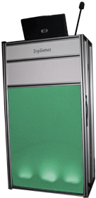
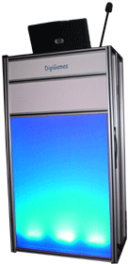
Measurement
Statistics and Probability
Algebra
Geometry
Number Sense
Estimation
& Computation
Problem Solving & Reasoning
$100
$100
$100
$100
$100
$100
$100
$200
$200
$200
$200
$200
$200
$200
$300
$300
$300
$300
$300
$300
$300
$400
$400
$400
$400
$400
$400
$400
$500
$500
$500
$500
$500
$500
$500

Slide 3
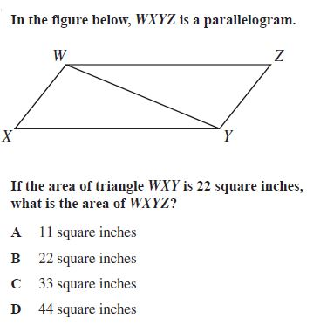
next

Slide 4
.
$100

Slide 5
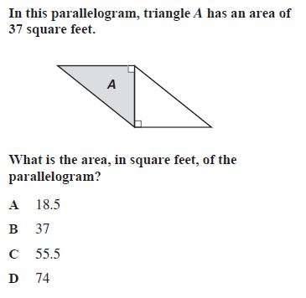
next

Slide 6
$200

Slide 7
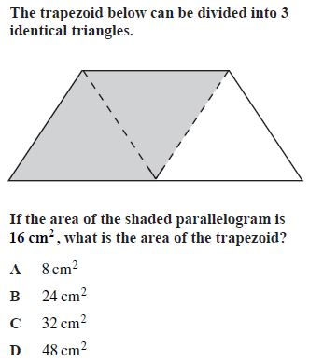
next

Slide 8
$300

Slide 9
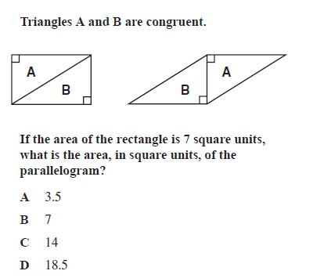
.
next

Slide 10
.
$400

Slide 11
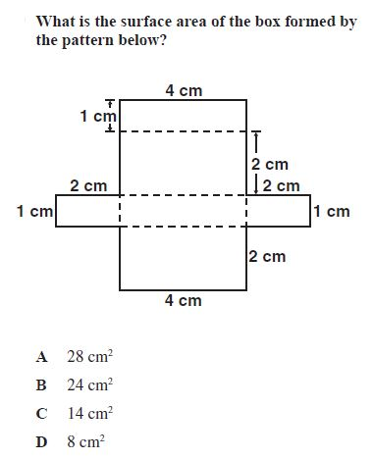
2
next

Slide 12
2
$500

Slide 13
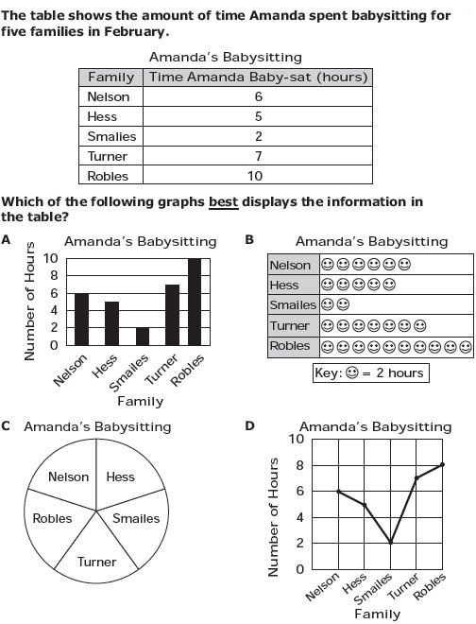
2
next

Slide 14
2
$100

Slide 15
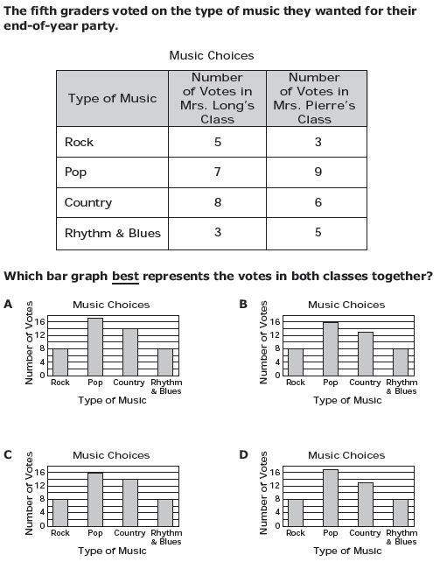
2
next

Slide 16
2
$200

Slide 17
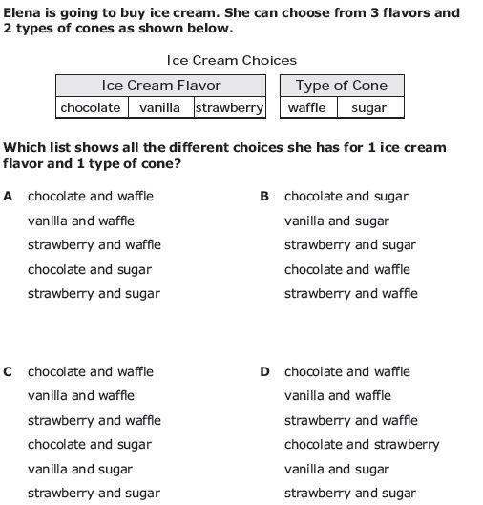
2
next

Slide 18
2 x 2
$300

Slide 19
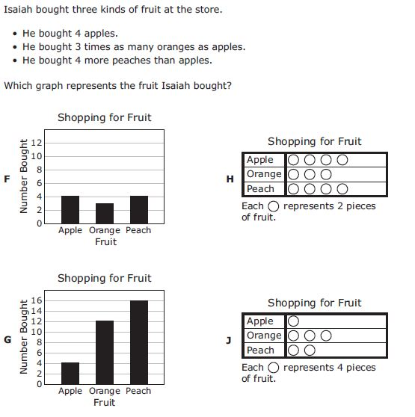
2 x 2
next

Slide 20
2 x 2
$400

Slide 21
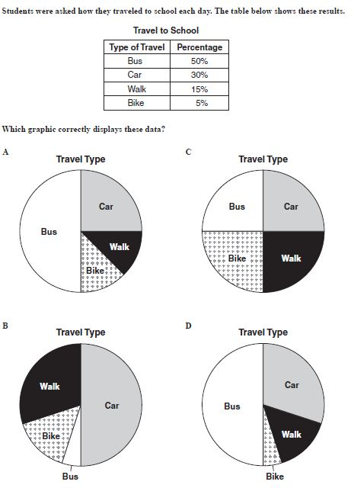
2 x 2
next

Slide 22
2 x 2
$500

Slide 23
2 x 2
next

Slide 24
2 x 2
$100

Slide 25
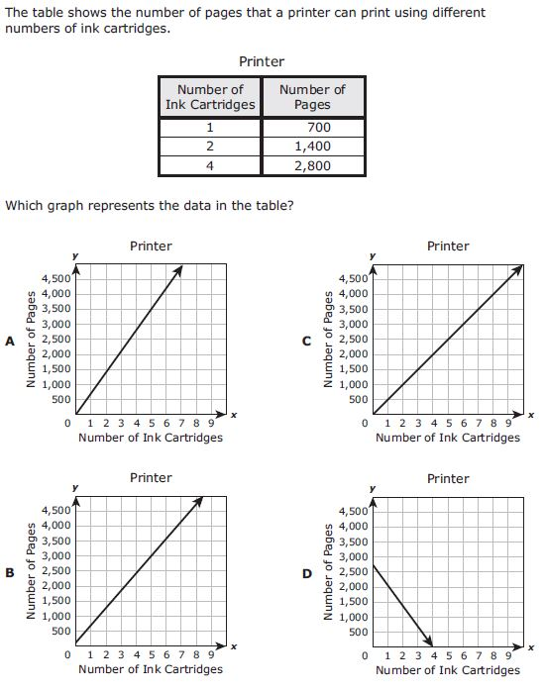
2 x 2
next

Slide 26
2 x 2
$200

Slide 27
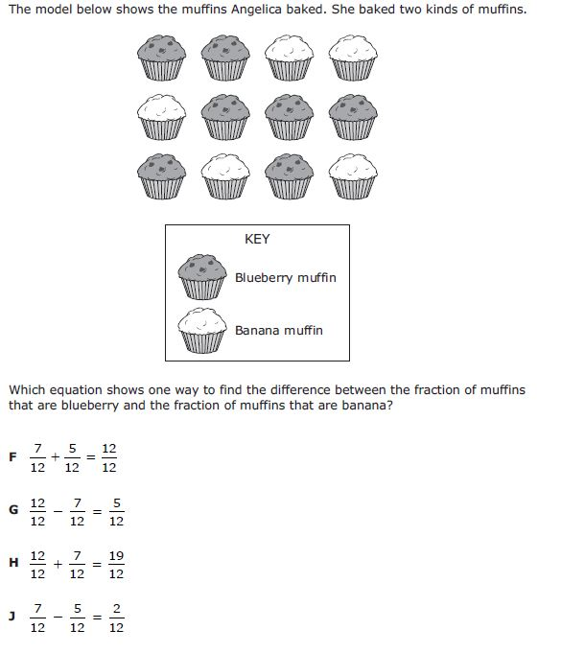
2 x 2
next

Slide 28
2 x 2
$300

Slide 29
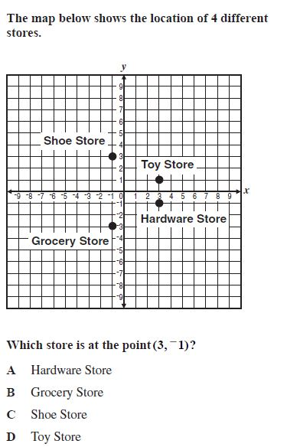
2 x 2
next

Slide 30
2 x 2
$400

Slide 31
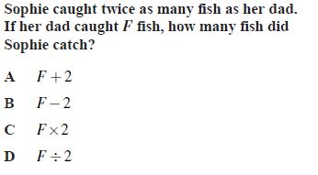
2 x 2
next

Slide 32
2 x 2
$500

Slide 33
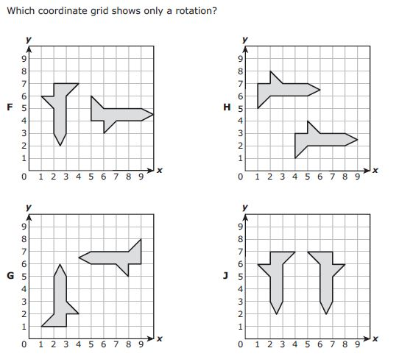
2 x 2
next

Slide 34
2 x 2
$100

Slide 35
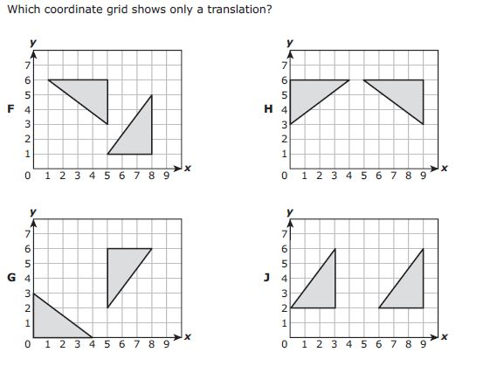
2 x 2
next

Slide 36
2 x 2
$200

Slide 37
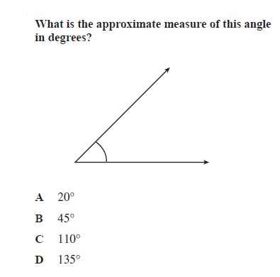
2 x 2
next

Slide 38
2 x 2
$300

Slide 39
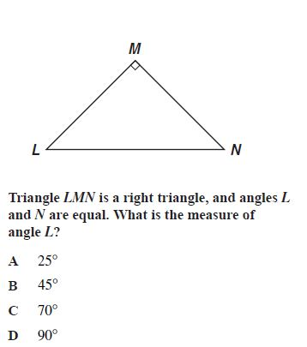
2 x 2
next

Slide 40
2 x 2
$400

Slide 41
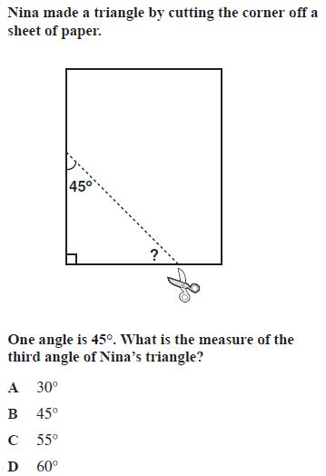
2 x 2
next

Slide 42
2 x 2
$500

Slide 43
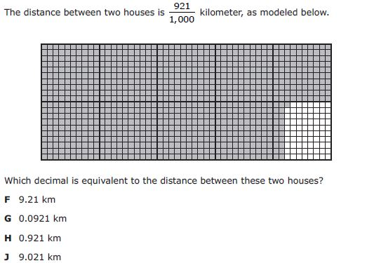
2 x 2
next

Slide 44
2 x 2
$100

Slide 45
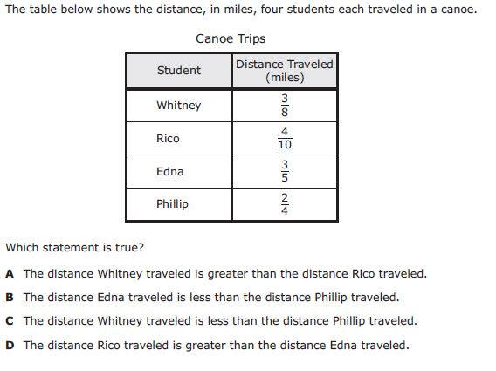
2 x 2
next

Slide 46
2 x 2
$200

Slide 47
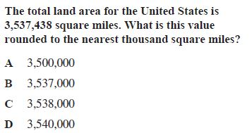
2 x 2
next

Slide 48
2 x 2
$300

Slide 49
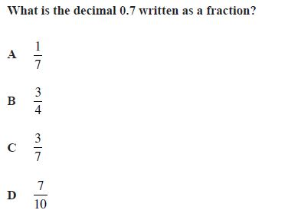
2 x 2
next

Slide 50
2 x 2
$400

Slide 51
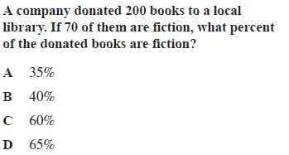
2 x 2
next

Slide 52
2 x 2
$500

Slide 53
2 x 2
next

Slide 54
2 x 2
$100

Slide 55
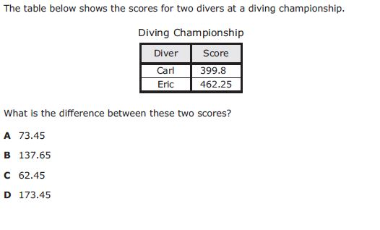
2 x 2
next

Slide 56
2 x 2
$200

Slide 57
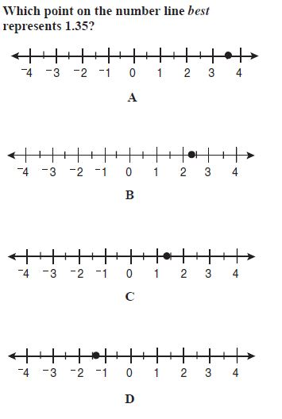
2 x 2
next

Slide 58
2 x 2
$300

Slide 59
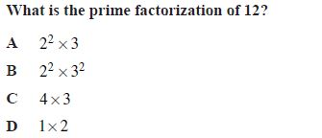
2 x 2
next

Slide 60
2 x 2
$400

Slide 61
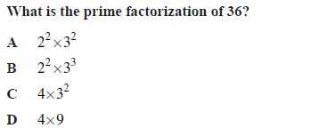
2 x 2
next

Slide 62
2 x 2
$500

Slide 63
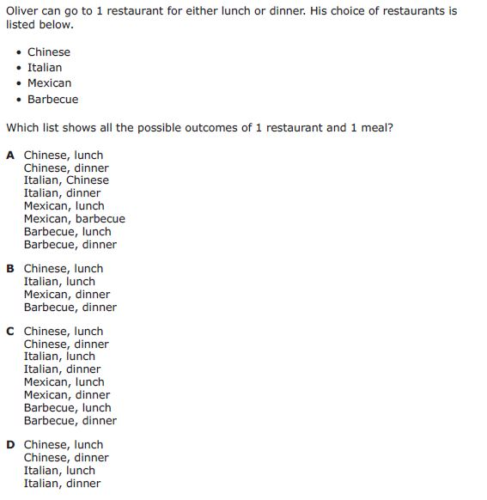
2 x 2
next

Slide 64
2 x 2
$100

Slide 65
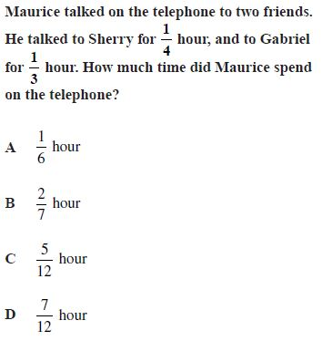
2 x 2
next

Slide 66
2 x 2
$200

Slide 67
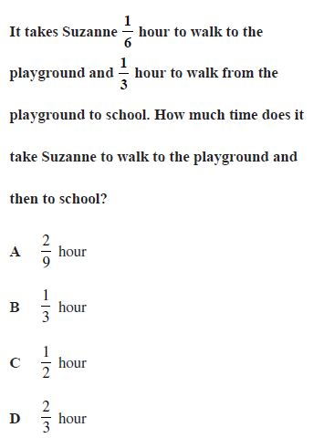
2 x 2
next

Slide 68
2 x 2
$300

Slide 69
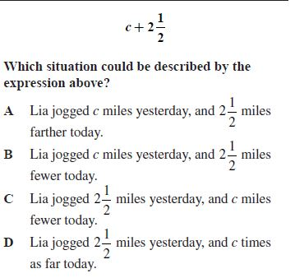
2 x 2
next

Slide 70
2 x 2
$400

Slide 71
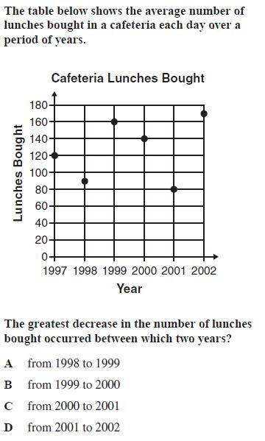
2 x 2
next

Slide 72
2 x 2
$500

Slide 73
Today’s Category: Problem Solving

Slide 74
next

Slide 75
Scores

