Slide 1
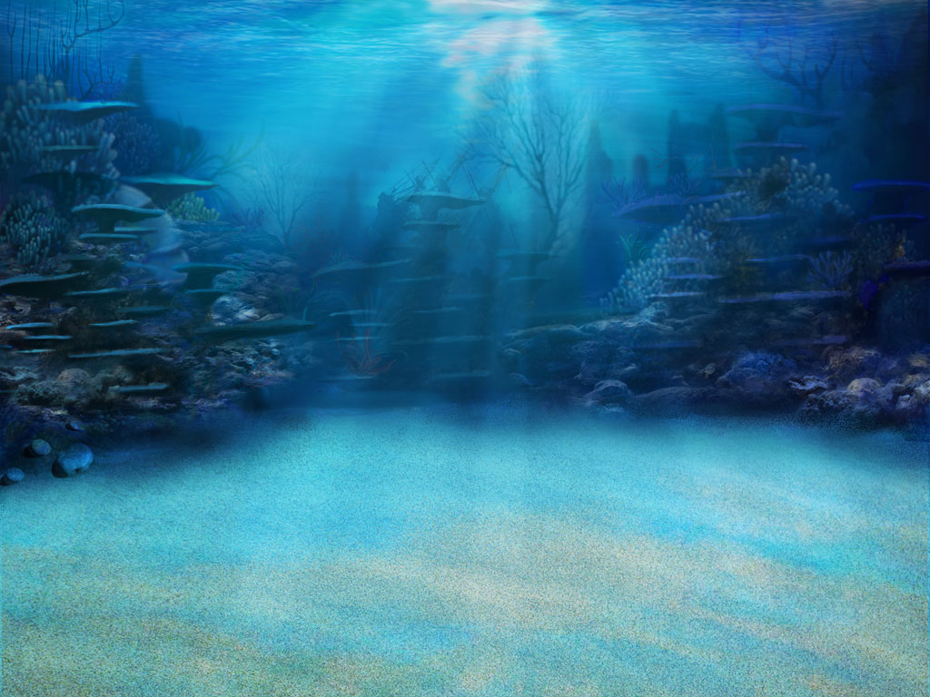
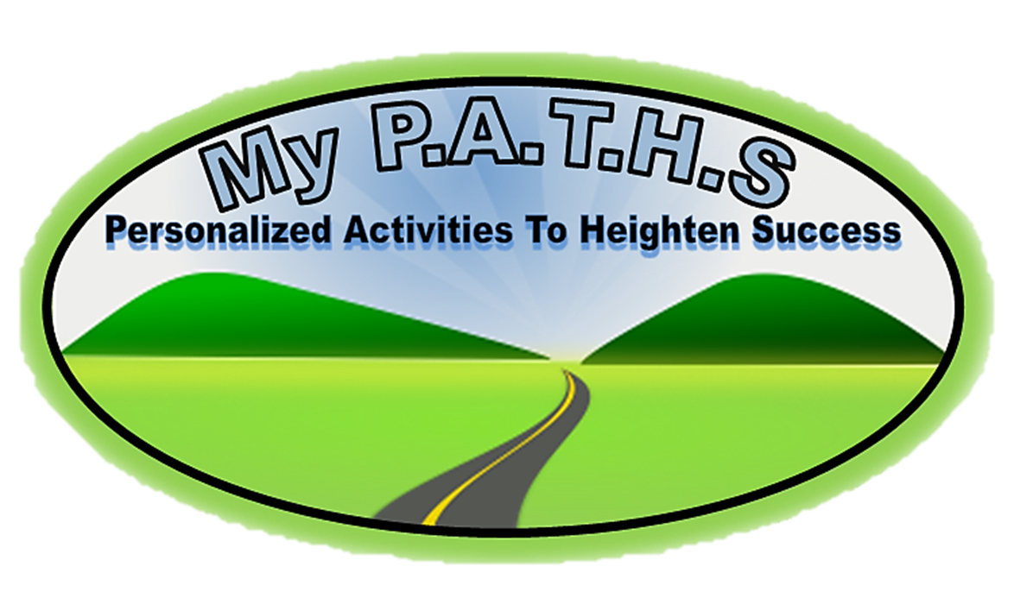
Product Purpose:
Having a challenge getting students to understand MAP and Common Core vocabulary? This game WILL help your students succeed! Words from the NWEA MAP site were placed in the specific RIT bands/Grade Levels associated with MAP.
This game is a great overview of all NWEA MAP vocabulary in the 211-220 RIT band.
This product includes the “Student Self-Assessment” sheet where students can assess their learning with each word while they go on their adventure!
Other RIT bands’ “Student Self-Assessment” sheets are included because some games include preview words for the next RIT band.
Click Logo

Slide 2
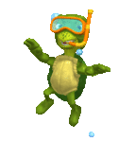
The Point Of The Game!!
Click Logo
In this game you will go on a underwater adventure as they investigate underwater life while trying to learn the critical vocabulary found in NWEA MAP RIT 211-220 and the Common Core. There are three games, with fifteen words in each games. This game can be paired with “NWEA MAP RIT 211-220 Student Tracking” sheet to allow students to self-assess and the teacher to progress monitor. Student click on a underwater species and a question floats in on the screen. Their goal is to click on the correct answer! Students can click on the floating turtle in the “My Progress” section to go to the selection page.
ALL NEW STUDENT WORD TRACKING FEATURE!!
When a student click on a word, the word appears under the “my progress” section as either being correct, or incorrect. Knowing how critical it is to understand what students know, this new feature allows both the teacher and the student to progress monitor their progress! When accompanied with “NWEA MAP RIT 211-220 Student Tracking” sheet, both the teacher and student can now set goals and monitor progress.
NWEA MAP RIT 211-220 Student Tracking Sheet Now Included!
To unlock the treasure chest, students simply click on the cage and a difficult question appears. If they get the question correct, the cage moves up and off the screen, and the chest is left opening and closing. This adds more excitement to the game.
MATERIALS: *Computers and/or *Classroom computer and Interactive Whiteboard

Slide 3
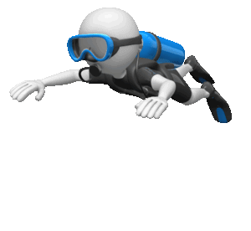
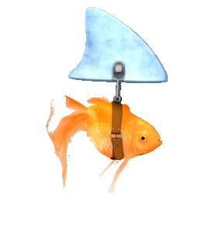
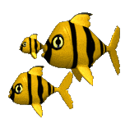
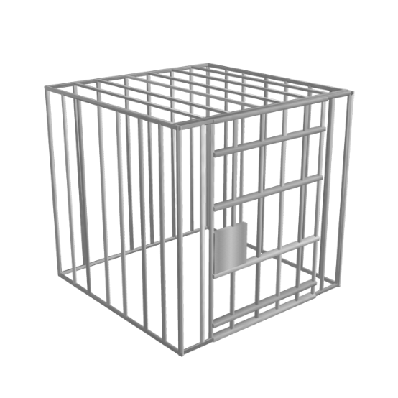
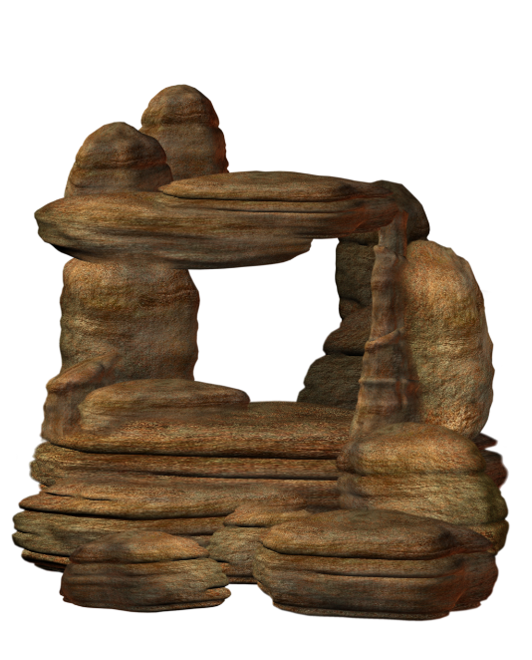
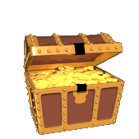
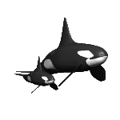
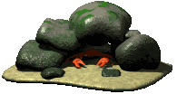
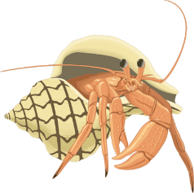
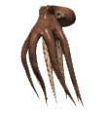
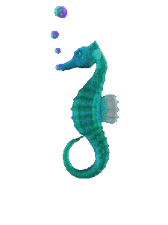
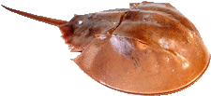
Jelly Fish 1.87 and .23
Green 1.86 and 1.15
Red 5.58 and 1
UNDERWATER ADVENTURE
NWEA MAP/COMMON CORE VOCABULARY RIT 211-220
ADVENTURE 1:
ALLUSION
APPENDIX CAUSE
CHARACTERIZE
CHRONOLOGICAL CLASSIFIED AD COUPON DEBATE DIAGRAM EXPOSITION FALLING ACTION FLASHBACK FORESHADOWING GUIDE LETTERS HEADLING
ADVENTURE 2:
HYPERBOLE
IDIOM
IMAGERY
INSTRUCTION
IRONY
MEMO
METAPHOR
NARATE
ONOMATOPOEIA
PARABLE
PERSONIFICATION
PERSUADIVE
PREDICTION
PRIMARY SOURCE
PUN
ADVENTURE 3:
QUOTE
RESOLVE
REVISION
SUBJECT SUSPENSE WORD PLAY
RIT 221-230
APHORISM
ASSONANCE
CONSONANCE
CONTRADICT
CONTRAST
FIRST PERSON
FORM
HOMOPHONE
JOURNALISM

Slide 4
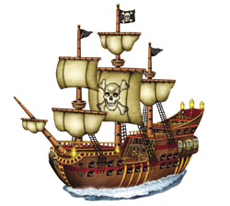
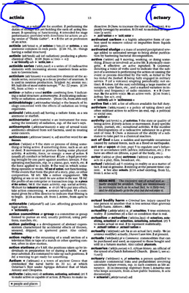
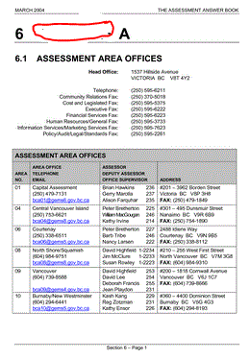
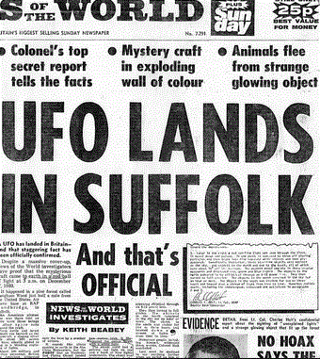
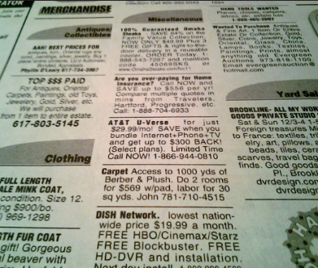
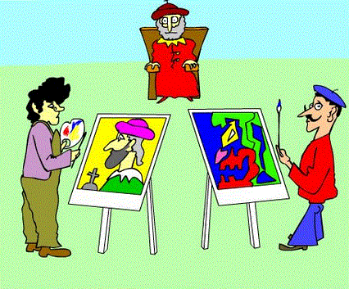
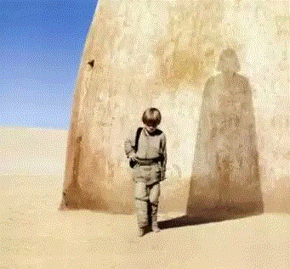
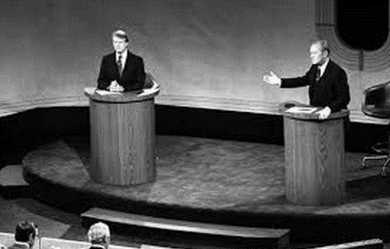
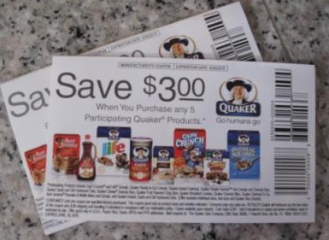
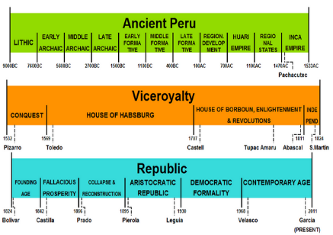
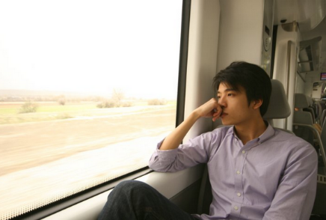
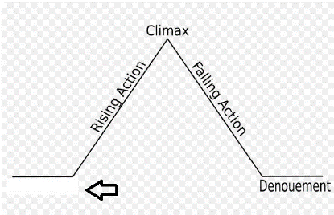
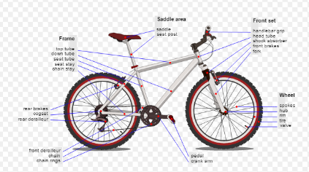
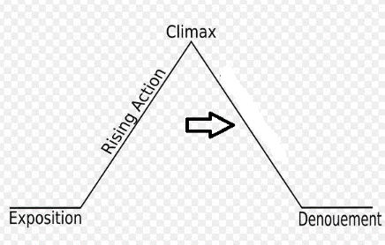
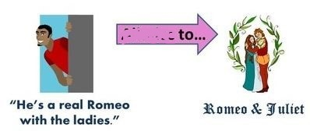
Jelly Fish 1.87 and .23
Green 1.86 and 1.15
Red 5.58 and 1
The introduction of a fictional story where you learn about the characters and the setting. (Example: The year was 1932, a young boy waits silently by a fire. His clothes torn and sweat falling from his forehead.)
My Progress
Materials like charts, organizers and graphs at the end of books. (Example: I saw a graphic organizer in the _________ located in the back of the book.)
A respectful and professional discussion between two sides with different points of view. (My friends and I had a _______________ over which is better vanilla ice cream, or chocolate.)
A section in a newspaper, magazine, or website that sells things like houses, apartments, used cars, and lists jobs. (Example: I looked in the newspaper in the __________________ to see if there were any job postings.)
A usually small piece of printed paper that saves you money for something you want to buy. (Example: My family was able to get $5 off because we had a _______________.)
The arrangement of things put in order of when they happened. (The timeline is arranged in _______________ order because it goes from the earliest date, to the latest time.)
The major news stories reported in newspapers, magazines, websites, or television news programs. (The _________ of the newspaper read “UFO Lands In Suffolk!”)
When something makes something else (effect) happen. (Example: The boy was not watching where he was going which could ________ him to trip down the stairs.)
When you don't specifically say what you are thinking, but instead try to get people to guess what you are thinking using obvious hints and clues. (Example: "Your nose is growing" would hint that someone thinks you are lying.)
One or more words printed on the top of the page of a reference book to help the reader locate the word he or she is looking for. (I used the _______________ “about” and “actually” at the top of the dictionary page to help me locate the word “acrostic”)
CAUSE
Going back to an earlier time in someone's life. (Example: The boy had a _____________ about the first time he had met the monster in his closet.)
To understand how the character acts and feels. (The two artists drew two different pictures that _____________ how they feel about the king.)
When a person gives hints to what will happen later in the story. You can predict what will happen from the events that have happened. (The fact that Jim did not study for the test will _______________ a bad day off school tomorrow.)
Events that happen after the climax. (The victory was amazing, but the effects of the win would soon be discovered when he saw his hand swollen from the game.)
Drawing that explains or shows the parts of something. (I really enjoyed looking at the ___________ of the bike.)
Guide
Letters
Falling
Action
ALLUDES
Headline
Falling Action
FALLING
ACTION
Characterize
Flashback
Classified Ad
Coupon
DEBATE
CAUSE
Foreshadowing
Exposition
APPENDIX
Exposition
Chronological
Diagram
Chronological
Headline
Exposition
Diagram
Classified Ad
Cause
Headline
APPENDIX
Coupon
ALLUDES
Debate
Foreshadowing
Flashback
Diagram
CHARACTERIZE
CHRONOLGICAL
Classified Ad
COUPON
DEBATE
DIAGRAM
EXPOSITION
FALLING ACTION
FLASHBACK
How much of the Earth’s total ocean water have we explored?
Foreshadowing
5%
2%
9%
17%
GUIDE LETTERS
HEADLINE

Slide 5
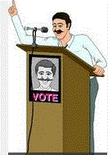
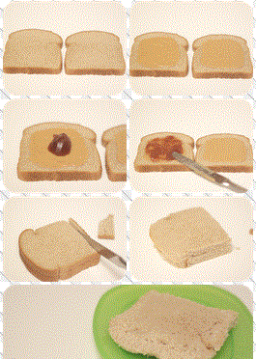
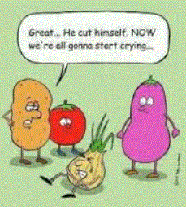
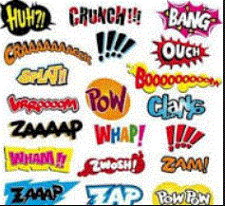
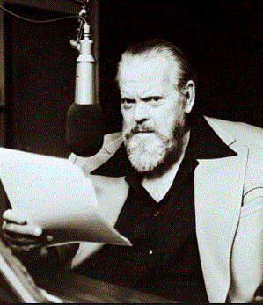
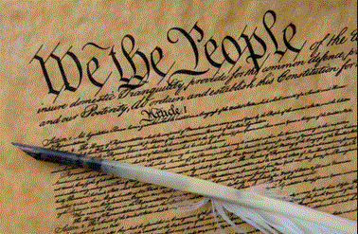
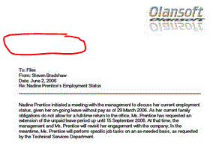
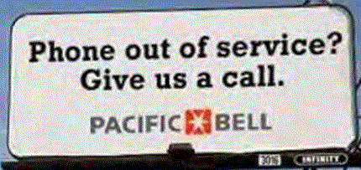
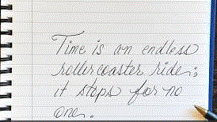
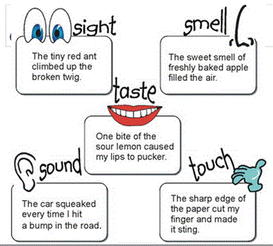
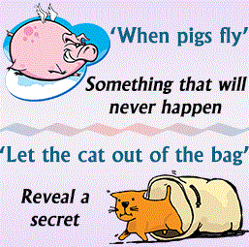
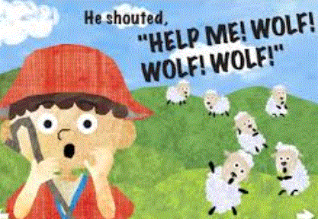
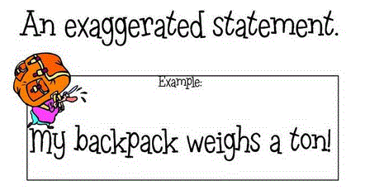
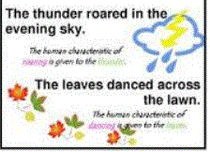
Jelly Fish 1.87 and .23
Green 1.86 and 1.15
Red 5.58 and 1
A document which was written or created during the time under study. (When we studied the Revolutionary War, we used the constitution as a _______________ to understand what was happening.)
My Progress
A situation that is strange or funny because things happen in a way that seems to be the opposite of what you expected. (A man who is a traffic cop gets his license suspended for unpaid parking tickets. It was ________ that the sign read “Phone out of service? Give us a call.”)
A type of text that describes how to do something. (Example: I had to follow the _____________ in order to make a peanut butter and jelly sandwich.)
A short written or typed message from one person or department to another person or department. (The water department wrote a _________ to the city reminding them to keep their water off.)
Giving non-human things, human qualities and abilities. (Examples: The girl used a great example of __________________ when she described how the sun smiled on us and how love slapped me in the face.)
A person not seen in the story that describes what is happening in the story. (Example: We heard the person who would _________ the show explain, “Two boys are sitting in front of a fire, preparing for tomorrows school prank.”) character’s actions.)
Language that causes people to see pictures in their mind. Words that make you hear, taste, smell, see, and touch what is going on in the writing. (Example: Where the ocean kissed the southern shore.)
A funny way to use the different definitions and meanings of words to create a cheesy joke. (Example: She's a skillful pilot whose career has really taken off. When the clock is hungry, it goes back for seconds.)
▪Words written as sound effects to help the reader hear the sounds that are happening in the story. (The writer used ____________ like Boom! Pop! Zing!)
When you try to get someone to do or believe something. (Example: I talked my sister into doing my school work. The man kept trying to be ___________ by using words that made him sound like the best candidate.)
A statement about what will happen or might happen in the future. (Example: I saw the dark clouds heading my way, so I ran in and got an umbrella.)
IRONY
A short story that teaches a moral or spiritual lesson. (The students sat and listened to the teacher read the ________________ about the “Boy Who Cried Wolf” because the teacher wanted the class to learn that people will not believe you if you make things up.
A comparison of different objects that have some kind of similarity without using "like" or "as". (Example: The bird was a bullet shooting towards the worm. Bird and bullet are both fast. Time is an endless rollercoaster ride; it stops for no one.
A phrase that has a literal and figurative meaning. If you do exactly what it says you may look very silly. (You blew your lid when you found out about your grade.)
An extreme exaggeration, authors use to get readers to notice part of a text. (“I have a mountain of homework!”)
Primary
Source
Pun
IMAGERY
Quote
MEMO
Prediction
Persuasion
Metaphor
MEMO
Personification
IRONY
Personification
IRONY
Idiom
Parable
Metaphor
PARABLE
Persuasive
Hyperbole
IDIOM
INSTRUCTIONS
Hyperbole
Hyperbole
Narrate
NARRATE
PREDICTION
Idiom
Idiom
INSTRUCTIONS
Onomatopoeia
IMAGERY
Instruction
MEMO
METAPHOR
NARRATE
IDIOM
HYPERBOLE
ONOMATOPOEIA
PARABLE
PERSONIFICATION
PERSUASION
What percent of the United States (in terms of our complete legal jurisdiction, which includes ocean territory) lies below the ocean.
PREDICTION
PRIMARY
SOURCE
42%
60%
50%
27%
PUN

Slide 6
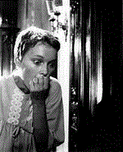
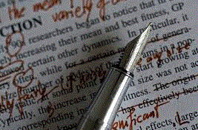
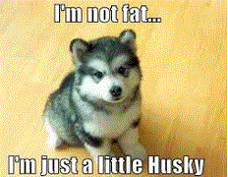
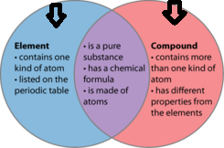
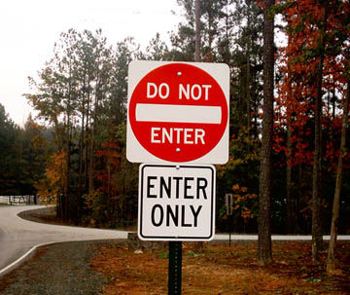
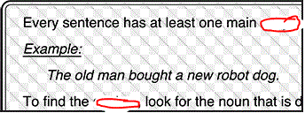
Jelly Fish 1.87 and .23
Green 1.86 and 1.15
Red 5.58 and 1
To compare (two people or things) to show how they are different. (The __________ between life in the city, and life in the countryside is quite remarkable in her country.)
My Progress
The act of saying something that is opposite or very different in meaning to something else. (Please don’t ____________ me when I am explaining the history lesson.)
A change or a set of changes that corrects or improves something. (Example: I had many mistakes on my paper so I had to make another __________ in order to fix them.)
Playing around with words, especially homonyms, to make them humorous. This is another way of explaining a pun. (Orange you glad I didn't see Banana)
A feeling of nervousness or excitement caused by wondering what will happen. (I felt a lot of _________ when I read, “The door slowly opened. My heart pounded as I hid under the bed. I saw footsteps coming at me. Suddenly...”)
The main topic that something is talking about. (Example: The newspaper was mainly about not giving homework to students. The ________ I have to do my report on is the Amazon Rainforest.)
When the author writes as though you are one of the characters in the story. (I, we) (me, us) (my/mine, our/ours is an example of _____________)
The activity or job of collecting, writing, and editing news stories for newspapers, magazines, television, or radio. (Mary is going to major in _____________ at college so she can become a writer.)
Giving non-human things, human qualities and abilities. (Examples: The girl used a great example of __________________ when she described how the sun smiled on us and how love slapped me in the face.)
Events that happen after the climax when the story Is close to the end. (The victory was amazing, but the effects of the win would soon be discovered when he saw his wrist swollen from the game.)
SUSPENSE
A wise saying that contains a truth and is often cliché. Think of the messages you get in Chinese cookies, or quotes that speak to you. (“A penny saved is a penny earned” is an example of an ____________)
The way in which the parts of a piece of writing or music or of a work of art are arranged (The writer chose poetic __________ to get his message across to the readers.)
Words that sound the same, but are spelled differently and have different meanings. (be, bee; steel, steal; to, two, too are examples of a ____________________).
Another word for alliteration where consonant sounds repeat within words. (All’s well that ends well is an example of __________)
Form
Falling
Action
SUBJECT
Homophone
Repetition of vowel sounds in the middle of words. ("Try to light the fire" is an example of a/an _________.)
Hyperbole
Aphorism
Falling Action
Third Person
First Person
Journalism
Suspense
Word Play
Consonance
Debate
Contrast
Resolve
Revision
Personification
Diagram
Irony
REVISION
Suspense
Assonance
Persuasion
Hyperbole
Contradict
Exposition
Revision
Subject
Flashback
Simile
Consonance
WORD PLAY
PERSONIFICATION
APHORISM
ASSONANCE
CONSONANCE
CONTRADICT
CONTRAST
FALLING ACTION
What percentage of life on Earth lives in the ocean?
FIRST
PERSON
FORM
97%
90%
86%
94%
HOMOPHONE
JOURNALISM

Slide 7
RESOURCE PAGE
THANK YOU TO PERSENTER MEDIA FOR PERMISSION TO USE ANIMATIONS, AND CLIPART FOR OUR PRODUCTS.
CONNECT WITH US AT:
mypersonalpaths@gmail.com
MyPATHS Blog
FACEBOOK
PINTEREST
RELATED PRODUCTS:
MAP TESTING READING QUIZZES COMPLETE RIT PACKAGE! (ALL RIT BANDS INCLUDED)
MAP TEST READING VOCABULARY GAME - Professor Lab coat (ALL RIT BANDS 141-260)
MAP TEST READING VOCABULARY GAME BUNDLE- Road Trip (ALL RIT BANDS 141-260)
MAP TEST READING VOCABULARY GAME - Real Bingo (ALL RIT BANDS 141-260)

