Slide 1
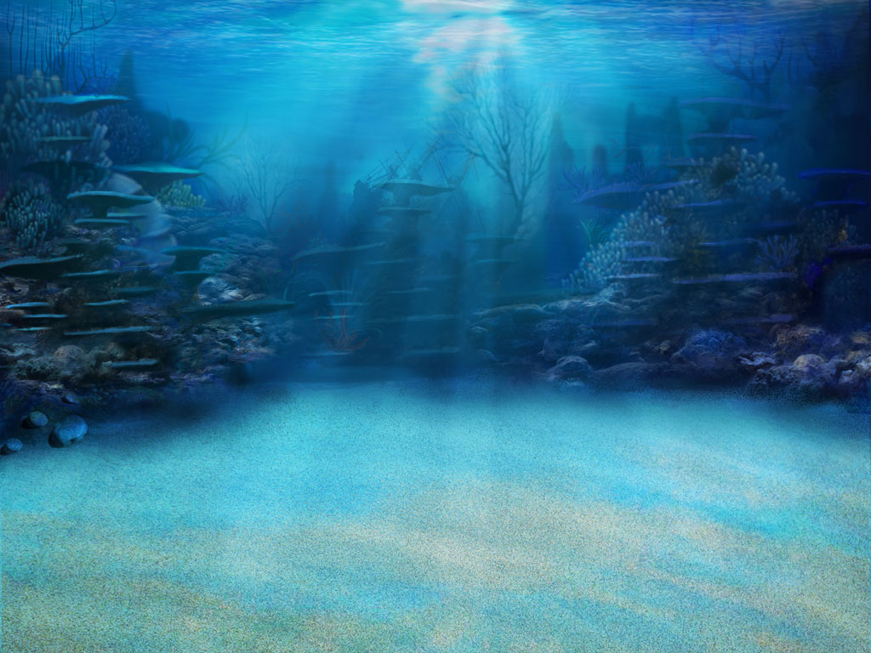
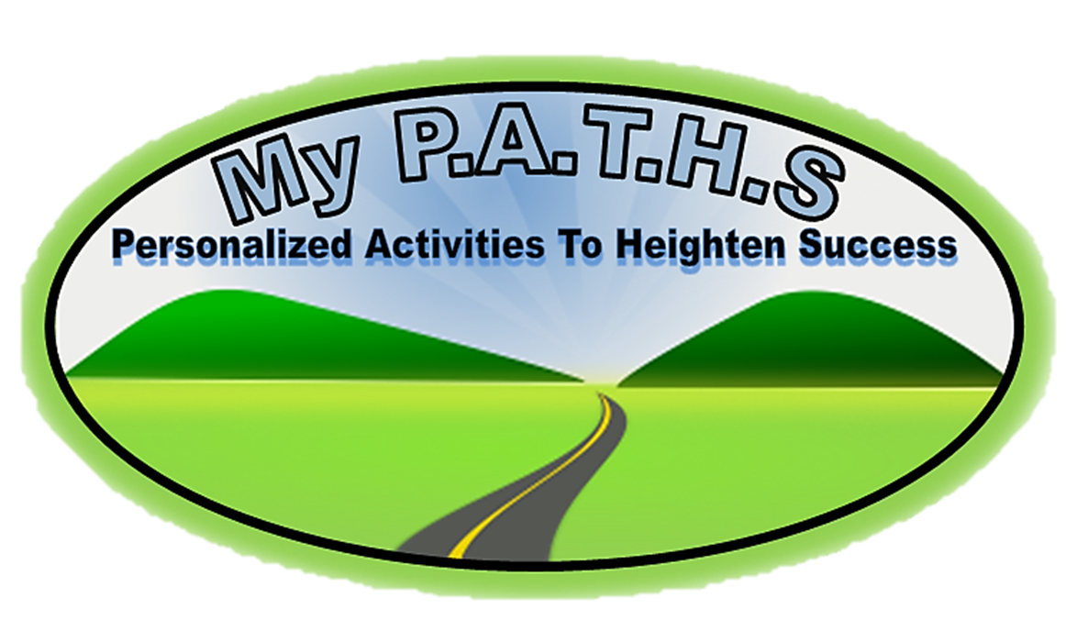
Product Purpose:
Having a challenge getting students to understand MAP and Common Core vocabulary? This game WILL help your students succeed! Words from the NWEA MAP site were placed in the specific RIT bands/Grade Levels associated with MAP.
This game is a great overview of all NWEA MAP vocabulary in the 221-260 RIT band.
This product includes the “Student Self-Assessment” sheet where students can assess their learning with each word while they go on their adventure!
Other RIT bands’ “Student Self-Assessment” sheets are included because some games include preview words for the next RIT band.
Click Logo

Slide 2
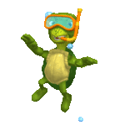
The Point Of The Game!!
Click Logo
In this game you will go on a underwater adventure as they investigate underwater life while trying to learn the critical vocabulary found in NWEA MAP RIT 221-260 and the Common Core. There are three games, with fifteen words in each games. This game can be paired with “NWEA MAP RIT 221-260 Student Tracking” sheet to allow students to self-assess and the teacher to progress monitor. Student click on a underwater species and a question floats in on the screen. Their goal is to click on the correct answer! Students can click on the floating turtle in the “My Progress” section to go to the selection page.
ALL NEW STUDENT WORD TRACKING FEATURE!!
When a student click on a word, the word appears under the “my progress” section as either being correct, or incorrect. Knowing how critical it is to understand what students know, this new feature allows both the teacher and the student to progress monitor! When accompanied with “NWEA MAP RIT 221-260 Student Tracking” sheet, both the teacher and student can set goals.
NWEA MAP RIT 221-260 Student Tracking Sheet Now Included!
To unlock the treasure chest, students simply click on the cage and a difficult question appears. If they get the question correct, the cage moves up and off the screen, and the chest is left opening and closing. This adds more excitement to the game.
MATERIALS: *Computers and/or *Classroom computer and Interactive Whiteboard

Slide 3
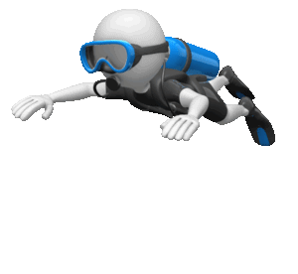
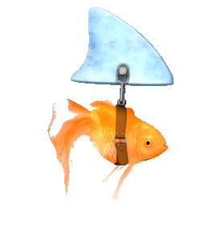
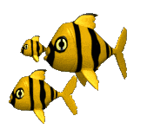
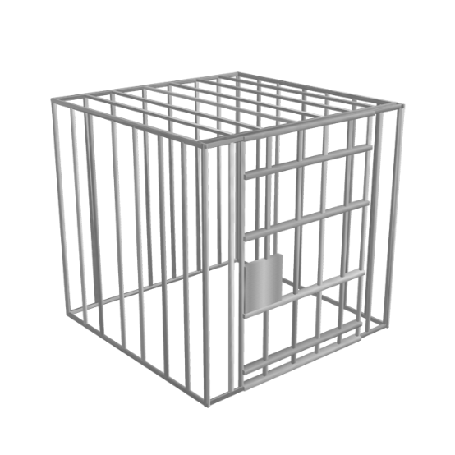
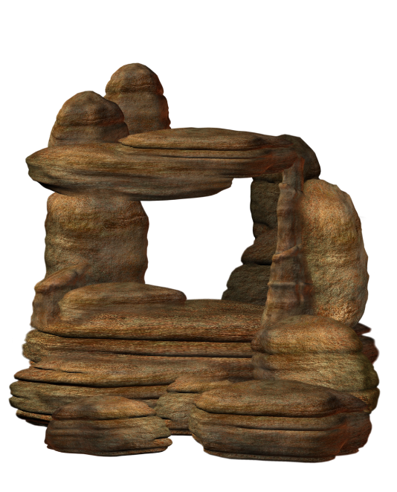
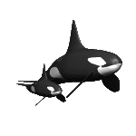
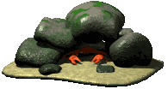
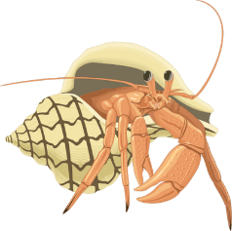
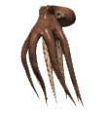
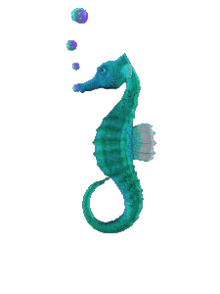
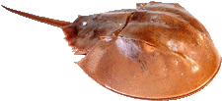
Jelly Fish 1.87 and .23
Green 1.86 and 1.15
Red 5.58 and 1
UNDERWATER ADVENTURE
NWEA MAP/COMMON CORE VOCABULARY RIT 221-260
ADVENTURE 1:
RIT 221-230
Aphorism
Assonance Consonance
Contradict
Contrast First Person
Form Homophone Journalism Literature Quotation Second Person Sonnet Symbolism Table
ADVENTURE 2:
Tale
Term
Third Person
Tone
Viewpoint
Voice
RIT 231-260
Archetype
Omniscient
Oxymoron
Paradox
Pathetic Fallacy
Stereotype
Symbolize
Syntax
Cliché
ADVENTURE 3:
Iambic Pentameter
Poetry Metric Feet
Synecdoche
Antithesis Parallelism Scansion
Review
Allusion
Chronological
Exposition
Falling Action
Flashback
Hyperbole
Idiom
Onomatopoeia
Personification

Slide 4
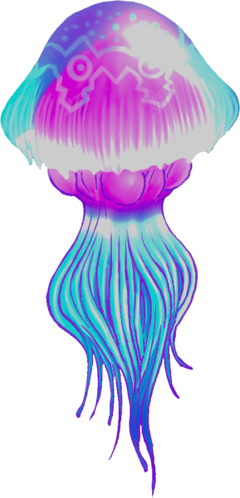
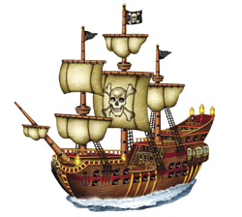
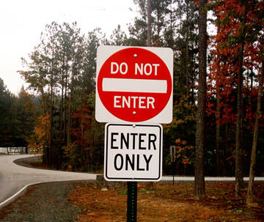
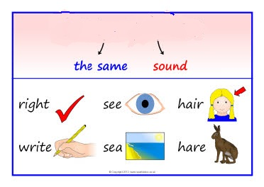
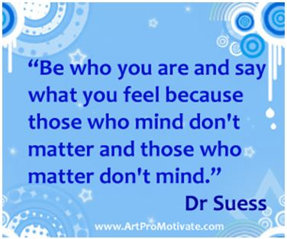
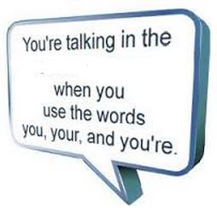
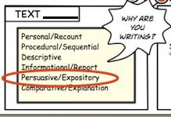
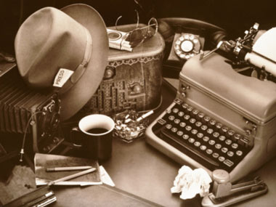
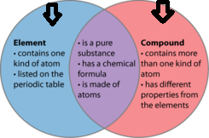
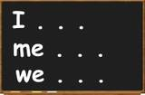
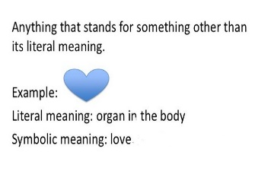
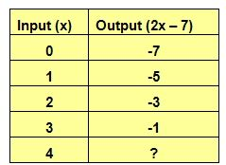
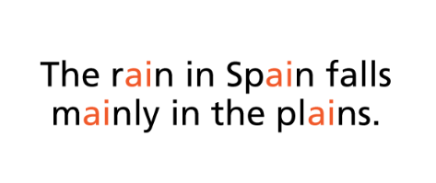
Jelly Fish 1.87 and .23
Green .64 and 1.12
Red 6.65 and 1.45
Written works (such as poems, plays, and novels) that are considered to be very good and to have lasting importance. (Henry David Thoreau is considered one of the greatest writers in American __________.)
My Progress
The act of saying something that is opposite or very different in meaning to something else. (Please don’t ____________ me when I am explaining the history lesson.)
To compare (two people or things) to show how they are different. (The __________ between life in the city, and life in the countryside is quite remarkable in her country.)
The activity or job of collecting, writing, and editing news stories for newspapers, magazines, television, or radio. (Mary is going to major in _____________ at college so she can become a writer.)
The way in which the parts of a piece of writing or music or of a work of art are arranged (The writer chose poetic __________ to get his message across to the readers.)
Words that sound the same, but are spelled differently and have different meanings. (be, bee; steel, steal; to, two, too are examples of a ____________________).
A wise saying that contains a truth and is often cliché. Think of the messages you get in Chinese cookies, or quotes that speak to you. (“A penny saved is a penny earned” is an example of an ____________)
Aphorism
Another word for alliteration where consonant sounds repeat within words. (All’s well that ends well is an example of __________)
Information presented and arranged in some sort of organized system. (The amount of rain we have had everyday this month is recorded in the ___________.)
When the author creates a story that uses the words “you, you’re” to make you feel like you are the character in the story. Often used in “Choose Your Own Adventure Stories.” (You went to the store, and you find yourself trapped in a maze.)
When the author writes as though you are one of the characters in the story. (I, we) (me, us) (my/mine, our/ours is an example of _____________)
When you take what someone says word-for-word and use it in your writing. (“To be or not to be is one of my favorite _____________.)
A poem made up of 14 lines that rhyme in a fixed pattern. (A Shakespearean ________is generally written with 10 syllables in each line.)
When something represents something other than its real meaning. For example, the United States flag represents many things.
Second
Person
Assonance
First
Person
Table
Sonnet
Symbolism
Repetition of vowel sounds in the middle of words. ("Try to light the fire" is an example of a/an _________.)
Quotation
Contrast
Journalism
Third Person
Homophone
Contradict
Form
Literature
Poem
Consonance
First Person
Simile
Consonance
Contrast
Aphorism
Diagram
Exposition
Plagiarism
Assonance
Literature
Contradict
Paragraph
Assonance
Journalism
Assonance
Consonance
Contradict
Contrast
First Person
Form
Homophone
Journalism
Literature
Quotation
If you extracted all the salt from the ocean it would cover all of the land on Earth to what depth?
Second
Person
5ft.
1ft.
9ft.
25ft.
Sonnet
Symbolism
Table

Slide 5
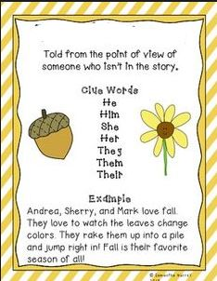
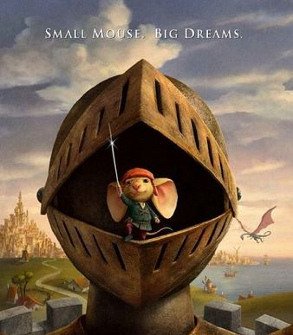
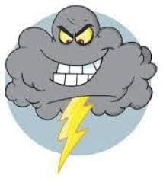
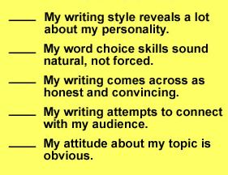
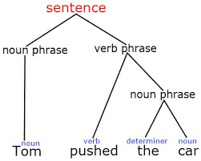
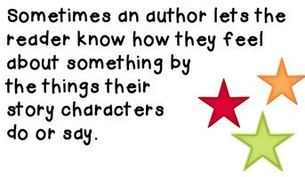
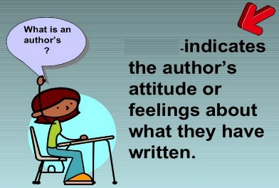
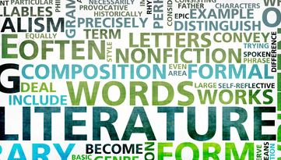
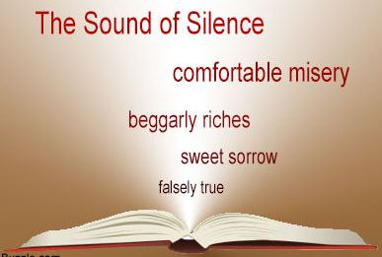
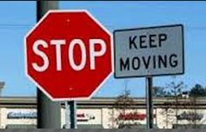
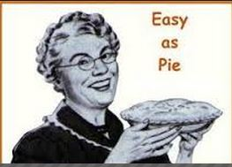
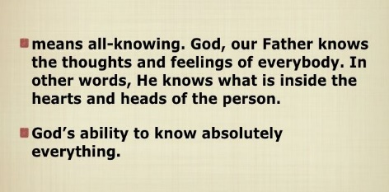
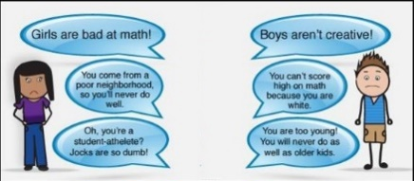
Jelly Fish 1.87 and .23
Green .64 and 1.12
Red 6.65 and 1.45
A statement that fights against itself because it contains two statement that are both true, but cannot be true at the same time. (You can save money by spending it, I'm nobody, wise fool, bittersweet, I can resist anything but temptation)
My Progress
A perfect example or idea that represent common patterns. (The Villain: A character whose main function is to go to any extent to oppose the hero; The Journey: The main character takes a journey that may be physical or emotional to understand his or her personality and the nature of the world)
When the author makes you feel like you are watching the whole story and are not a character. (In a book written in __________ you read these words a lot: he, she, it, him, her)
Very common phrases/ideas that are used too much. (my way or the highway, when you can predict endings to movies because it always seems to happen)
Means all knowing, in writing it’s a type of third person point of view where a narrator seems to be able to tell you the thoughts and feelings of all characters.
An unfair belief that all people or things that have a certain characteristic are a certain way. (All people with glasses are smart/nerds, all blondes are not smart, and some countries think all Americans are selfish and lazy.)
Tale
In fiction: it’s the way the story is told. In nonfiction it’s the opinion of the author. (The author’s _________ on religion is very obvious in the story.)
When you can tell someone's personality from their writing. (The writer’s __________ shows his attitude about the character’s in the story.)
When you use an image, shape, color, or other simple visual to stand for something else. (This picture is the represents peace.)
Imaginative narrative of an event. (I really enjoyed reading the ….. about the adventure of the mouse and the king.)
The feelings/attitude that you infer the author seems to have from their writing. (The __________ of the story is dark and lonely.)
Combination of words that do not seem to go together. (awfully pretty, good problem, jumbo shrimp)
Similar to personification, but gives human emotions to nonhuman objects. (weeping clouds, lonely hills, furious gusts of wind)
Pathetic
Fallacy
Term
Rules words must follow so they can be put together in order to create sentences. (Look at the example: Tom pushed the car)
Word or phrase that has a meaning. (The __________ diffusion is used in my social studies textbook.)
Tone
Syntax
Cliché
Symbolize
Voice
Term
Stereotype
Term
Third Person
Symbolize
Viewpoint
Paradox
Cliché
Tale
Stereotype
Definition
Poem
Third Person
Omniscient
Viewpoint
First Person
Archetype
Paradox
Oxymoron
Exposition
Voice
Oxymoron
Archetype
Omniscient
Stereotype
Tone
Viewpoint
Voice
Archetype
Omniscient
Oxymoron
Paradox
Pathetic Fallacy
How high was the largest Tsunami ever recorded?
Stereotype
Symbolize
90ft.
50ft.
30ft.
210ft.
Syntax
Cliche

Slide 6
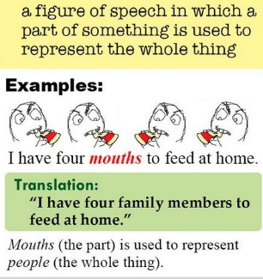
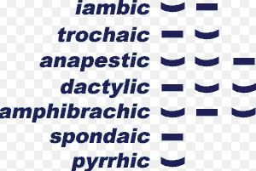
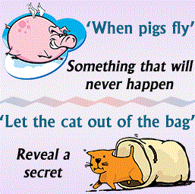
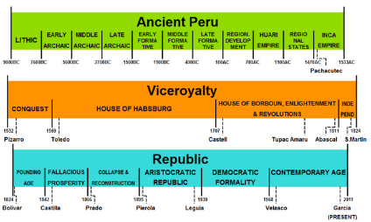
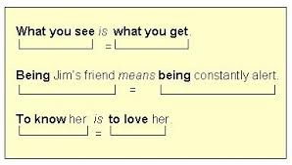
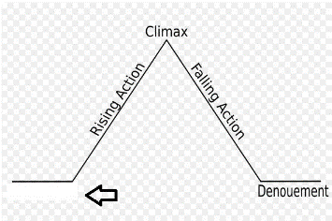
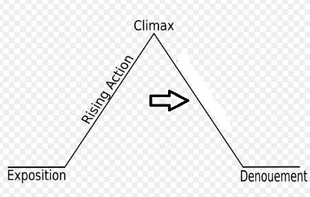
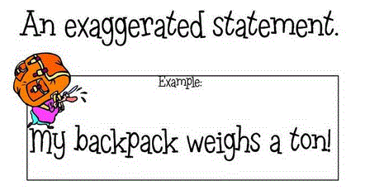
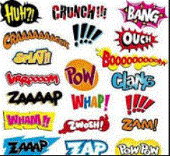
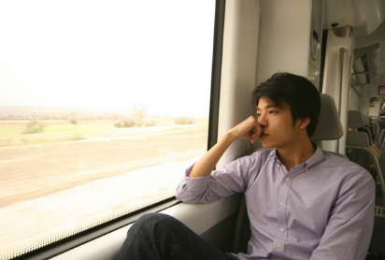
Jelly Fish 1.87 and .23
Green .64 and 1.12
Red 6.65 and 1.45
My Progress
The arrangement of things put in order when they happened. (The timeline is arranged in _______________ order because it goes from the earliest date, to the latest time.)
Events that happen after the climax, when the story begins to get towards the end. (The victory was amazing, but the effects of the win would soon be discovered when he saw his fish belly up in the aquarium.)
When you don't specifically say what you are thinking, but instead try to get people to guess what you are thinking using obvious hints and clues. (Example: "Your nose is growing" would hint that someone thinks you are lying.)
A figure of speech in a piece/part of something is used to represent the whole thing. (Check out my new wheels-look at my car. Hired hands-means workers. I have four mouths to feed at home-I have four family members to feed at home.)
Iambic Pentameter
When you scan a verse in a poem to try to figure out its meter and rhythm. Similar to how you annotate a text with special markings, how you annotate a poem with special markings for meter and rhythm.
A line of verse with five metrical feet, each consisting of one short (or unstressed) syllable followed by one long (or stressed) syllable, (Two households, both alike in dignity, what light through yonder window breaks.)
Use elements in sentences that are identical in sound and meaning. (This is not just what I wanted, but what I needed; Congress needs to either reduce spending or raise taxes)
A phrase that has a literal and figurative meaning. If you do exactly what it says you may look very silly. (You blew your lid when you found out about your grade.)
Two opposite ideas put together. (Snow White and the Wicked Witch, Dumbledore and Voldemort, Candy and a healthy diet.)
Giving non-human things, human qualities and abilities. (Examples: The girl used a great example of __________________ when she described how the sun smiled on us and how love slapped me in the face.)
The introduction of a fictional story, where you learn about the characters and the setting. (Example: The year was 1932, a young boy waits silently by a fire. His clothes torn and sweat falling from his forehead.)
Words written as sound effects to help the reader hear the sounds that are happening in the story. (The writer used ____________ like Boom! Pop! Zing!)
Going back to an earlier time in someone's life. (Example: The boy had a _____________ about the first time he had met the monster in his closet.)
An extreme exaggeration, authors use these to get readers to notice a part of text. (“I have a mountain of homework!”)
Poetic Metric
Feet
Poetry Metric Feet
Idiom
Poetry Metric Feet
Idiom
Iambic Pentameter
Iambic
Pentameter
A group of 2 or 3 syllables forming the basic unit of poetic rhythm.
Onomatopoeia
Idiom
Falling Action
Antithesis
Chronological
Flashback
Exposition
Parallelism
Hyperbole
Scansion
Synecdoche
Exposition
Foreshadowing
Allusion
Parallelism
Personification
Diagram
Antithesis
Hyperbole
Scansion
Hyperbole
Exposition
Characterize
Resolution
Synecdoche
Antithesis
Parallelism
Scansion
Allusion
Chronological
Exposition
Falling Action
Flashback
Hyperbole
Phytoplankton in the ocean are responsible for producing what percent of our oxygen?
Idiom
20%
50%
90%
17%
Onomatopoeia
Personification

Slide 7
RESOURCE PAGE
THANK YOU TO PERSENTER MEDIA FOR PERMISSION TO USE ANIMATIONS, AND CLIPART FOR OUR PRODUCTS.
CONNECT WITH US AT:
mypersonalpaths@gmail.com
MyPATHS Blog
FACEBOOK
PINTEREST
RELATED PRODUCTS:
MAP TESTING READING QUIZZES COMPLETE RIT PACKAGE! (ALL RIT BANDS INCLUDED)
MAP TEST READING VOCABULARY GAME - Professor Lab coat (ALL RIT BANDS 141-260)
MAP TEST READING VOCABULARY GAME BUNDLE- Road Trip (ALL RIT BANDS 141-260)
MAP TEST READING VOCABULARY GAME - Real Bingo (ALL RIT BANDS 141-260)

