Slide 1
PowerPoint
© Erin Kathryn 2014

Slide 2
The Constitution divides the national
government into three parts, or branches:
legislative branch
executive branch
judicial branch
Each branch does a different job.
© Erin Kathryn 2014

Slide 3
LEGISLATIVE BRANCH
Congress
Makes the laws
Has two parts:
Senate and the House of
Representatives
Senate | House of Representatives
Each state has 2 | Depends on the state population
© Erin Kathryn 2014

Slide 4
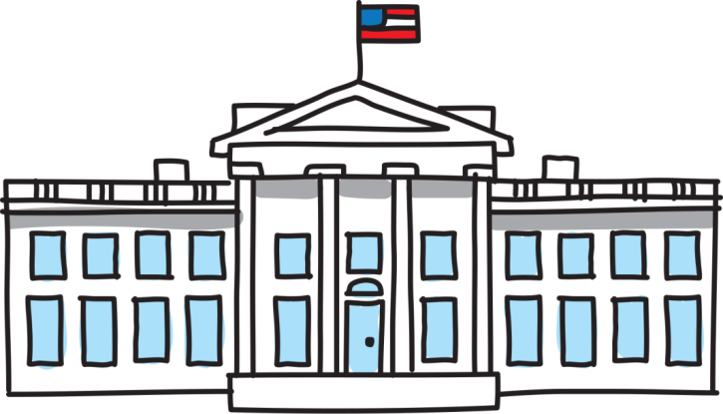
EXECUTIVE BRANCH
President
Enforces, or carries out, the laws made by Congress.
Examples: Department of Justice and Environmental Protection Agency
© Erin Kathryn 2014

Slide 5
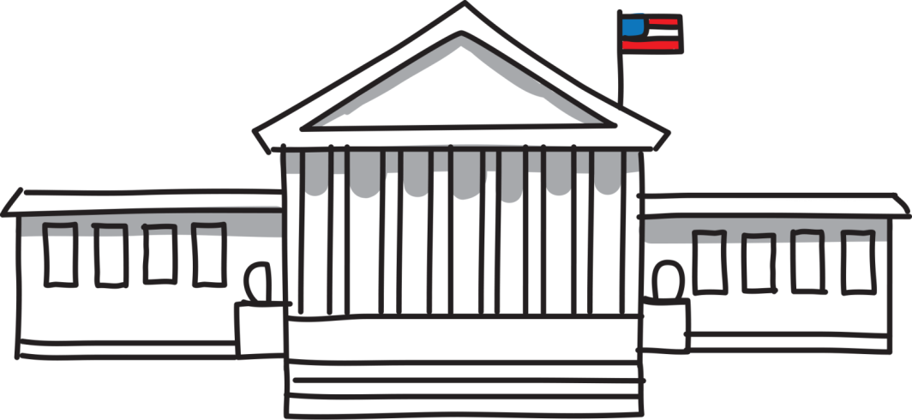
JUDICIAL BRANCH
Highest court: Supreme Court
Decides the meanings of law and whether laws are being obeyed
© Erin Kathryn 2014

Slide 6
Checks and Balances
The Constitution created a government
with three branches to make sure that
the government never held too much power.
Power is divided among the three branches.
To prevent each branch from becoming
stronger than another, a system of checks and balances was set up.
Checks and balances are a system that allows
each branch to limit or control
the power of the other two.
© Erin Kathryn 2014

Slide 7
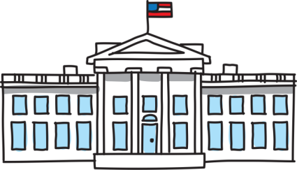
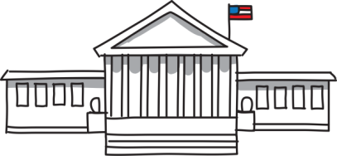
Checks and Balances
President
(Executive Branch)
Congress
(Legislative Branch)
Supreme Court
(Judicial Branch)
© Erin Kathryn 2014

Slide 8
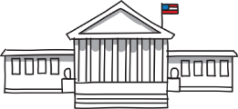
Separation of Powers
Legislative
Judicial
Executive
Supreme Court
Congress
President
Circuit Courts
House
of
Representatives
Senate
Vice
President
Cabinet
District Courts
© Erin Kathryn 2014

