Slide 1
Map Skills
The continents and oceans

Slide 2
Key Terms
Globe – small model or copy of the Earth
Map – flat drawing of a place
Equator – an imaginary line that circles the Earth between the North and South Poles, dividing it into north and south.
Continent – a large body of land on Earth (7)
Ocean – a large, salty body of water on Earth (4)

Slide 3
“The 7 Continents” (to the tune of “99 Bottles of Milk on the Wall”)
To learn the 7 continents
Think of the letter A
And when you’re down to only 1
An E will save the day!
There’s Africa, Antarctica
Australia, Asia too
An ocean runs between them
With waters deep and blue.
There’s also 2 Americas
North and south, you see
Now we’re coming to the end
Europe starts with E!

Slide 4
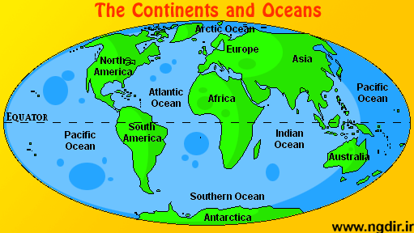
The continents & oceans
Europe
North America
Asia
Africa
South America
Australia
Antarctica

Slide 5
“The Oceans Song” (to the tune of “The More We Get Together”)
Can you name all the oceans?
The oceans?
The oceans?
Can you name all the oceans?
There are only five!
The Pacific
The Atlantic
The Indian
The Arctic
The Southern is the last one.
Let’s go take a dive!

Slide 6
The continents & oceans
Arctic Ocean
Europe
North America
Asia
Atlantic Ocean
Pacific Ocean
Africa
Equator
South America
Pacific Ocean
Indian Ocean
Australia
Southern Ocean
Antarctica

Slide 7
Key Terms
Symbols – drawings on a map that represent places
Map key – the part of a map that explains the symbols
Cardinal directions – north, east, south, west
Intermediate directions – northeast, southeast, southwest, northwest
Compass rose – the part of a map that shows direction

Slide 8
Cardinal Directions

Slide 9
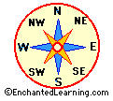
Intermediate Directions

Slide 10
Continents and Oceans Quiz
What are the 7
continents on Earth?
_______________
_______________
_______________
_______________
_______________
_______________
_______________
What are the 4 oceans
on Earth?
_______________
_______________
_______________
_______________
_______________

